Slide 1
Chris Sainsbury
Consultant Physician (Diabetes & Endocrinology)
Gartnavel General Hospital
c.sainsbury@nhs.net
@csainsbury
http://glucose.ai
Notes:
1

Slide 2
What’s new in diabetes?
Type 1 diabetes
focus on glucose variability as metric
techniques to reduce variability: new insulins, CGMS / flash glucose monitoring, closed-loop sensor/pump systems
Type 2 diabetes
focus on glucose variability as key metric
move from surrogate to outcome driven therapeutic choices
Notes:
2

Slide 3
Type 1 Diabetes
Notes:
3

Slide 4
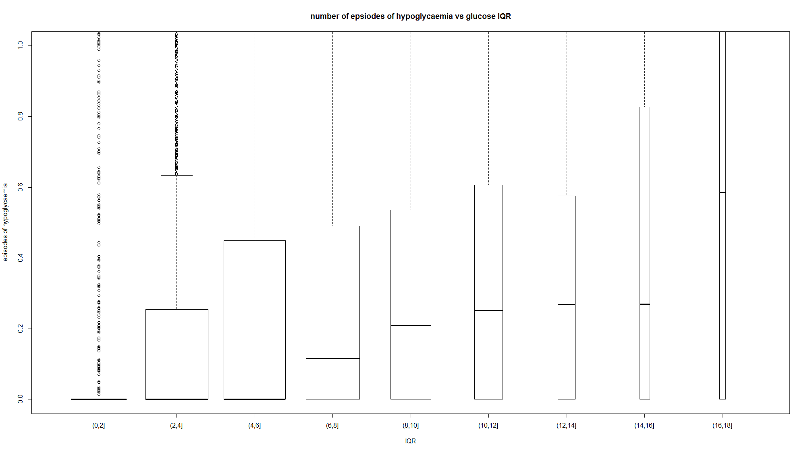
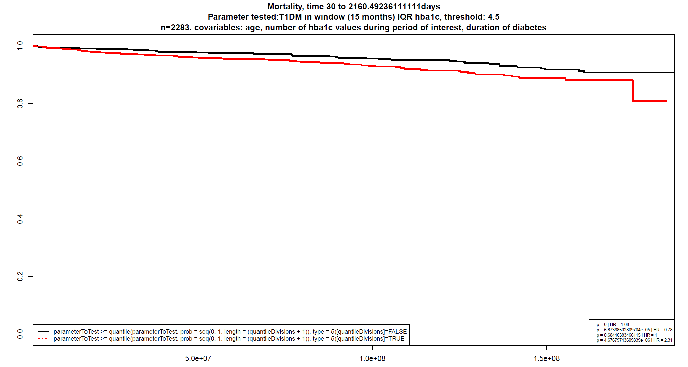
Type 1 diabetes: Glucose Variability
median glucose (HbA1c associated with complications) – has traditionally driven management decisions
multiscale glucose variability associates with short and long term outcomes (hypoglycaemia / mortality)
CBG variability vs inpatient hypoglycaemia rate
HbA1c variability vs 5y mortality (1)
1 Sainsbury et al, in press, Diabetic Medicine 2017
Notes:
4

Slide 5
Type 1 diabetes: Strategies to reduce glycaemic variability
improve patient view of glucose throughout 24h period
(CGMS / flash monitoring)
improve insulin requirement / delivery matching
- structured education / DAFNE
improve insulin kinetics / delivery mechanism
- new insulins
- insulin pump / closed loop systems
intelligent ML based systems to assist decision making
Notes:
5

Slide 6
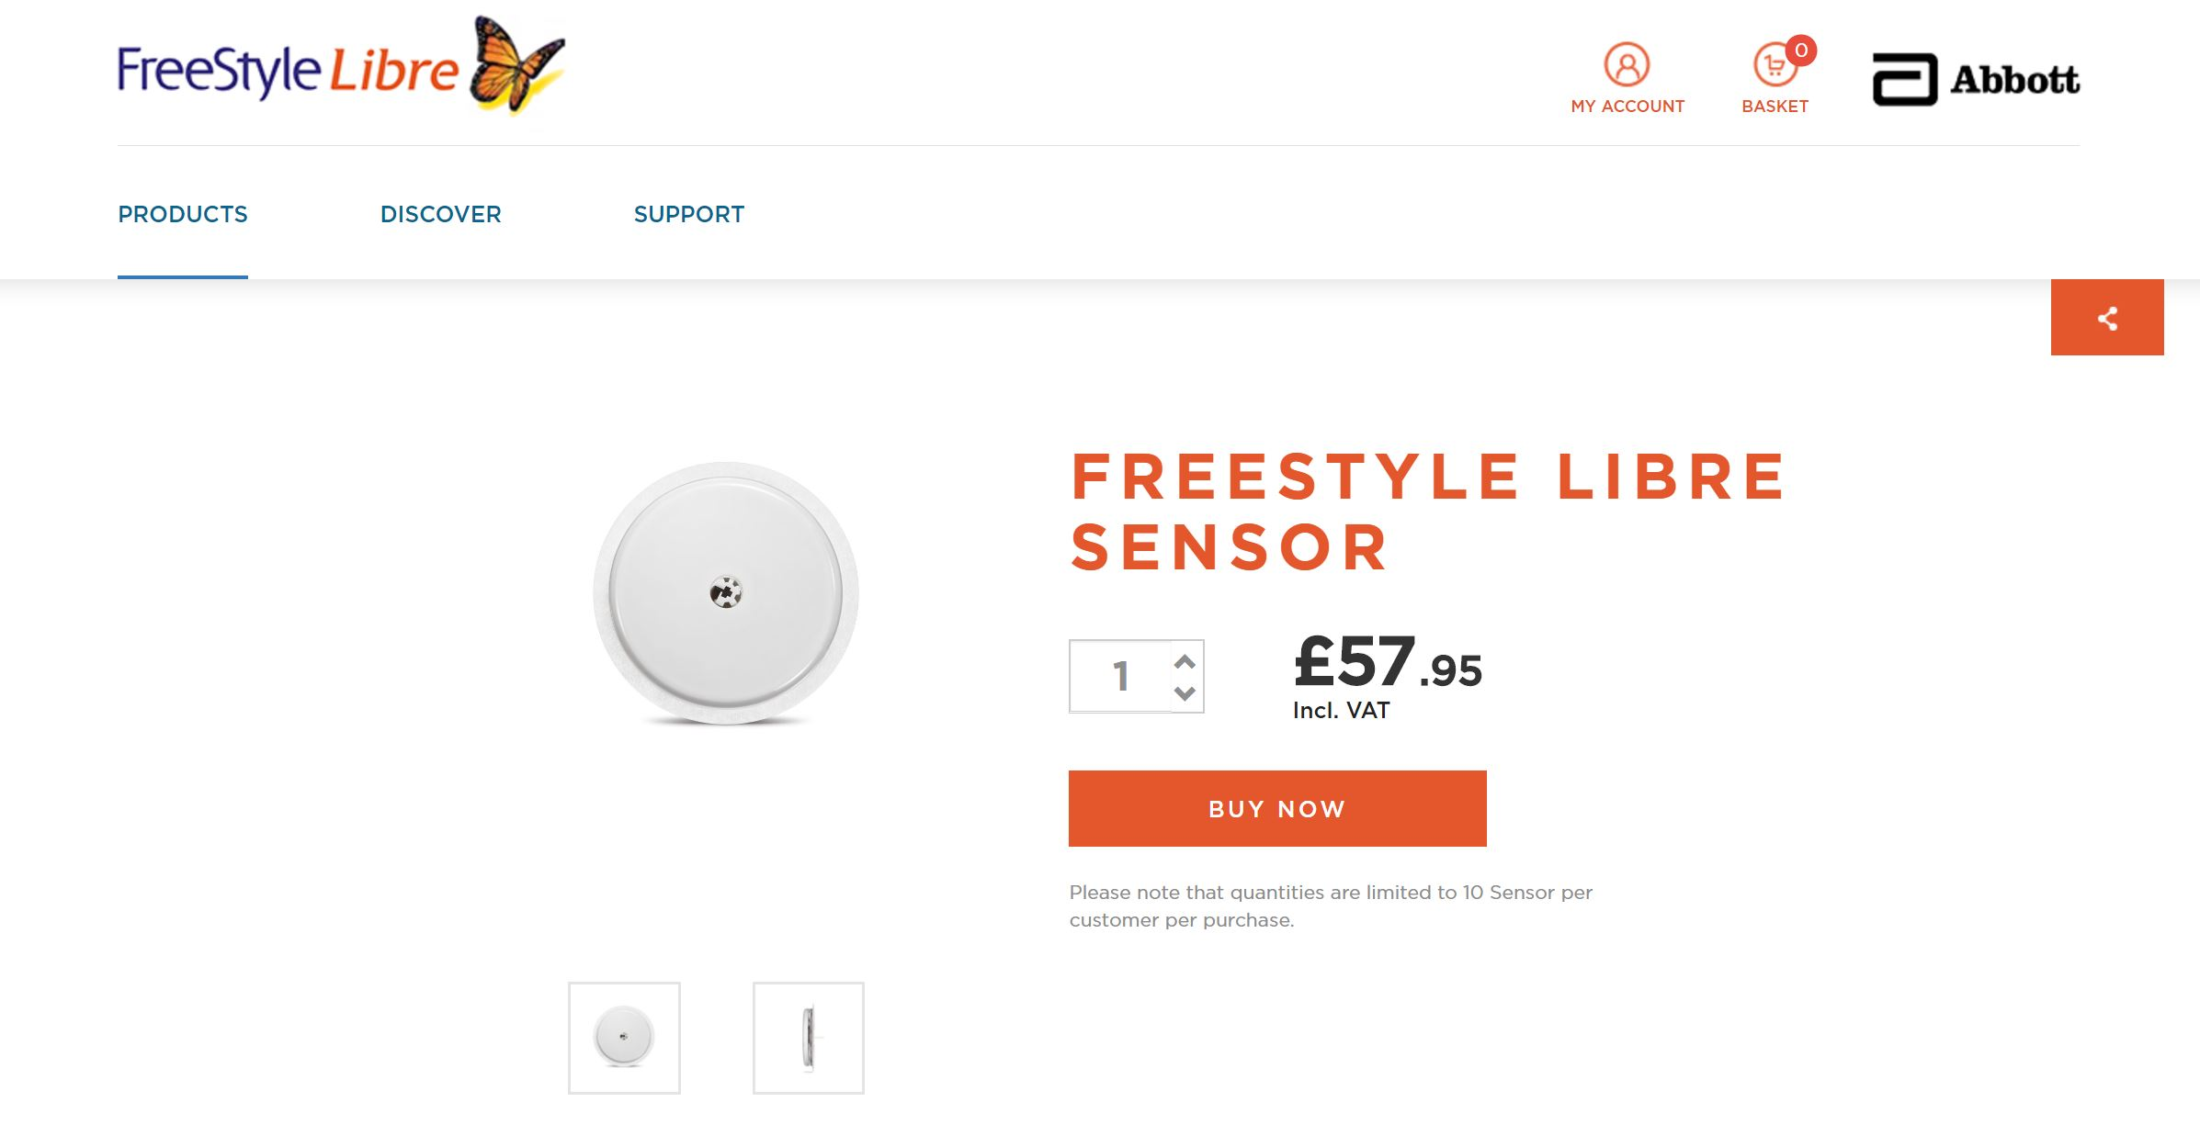
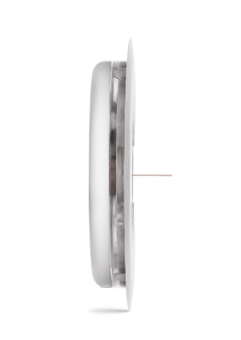
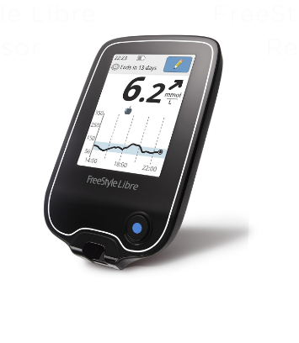
Type 1 diabetes: flash monitoring
Abbott Freestyle Libre
Notes:
6

Slide 7
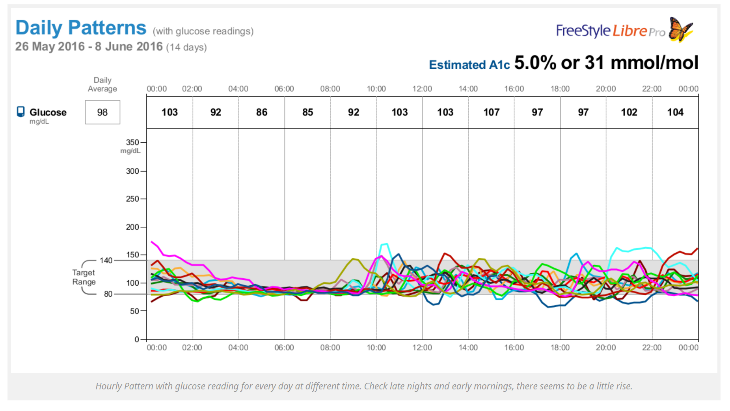

Slide 8
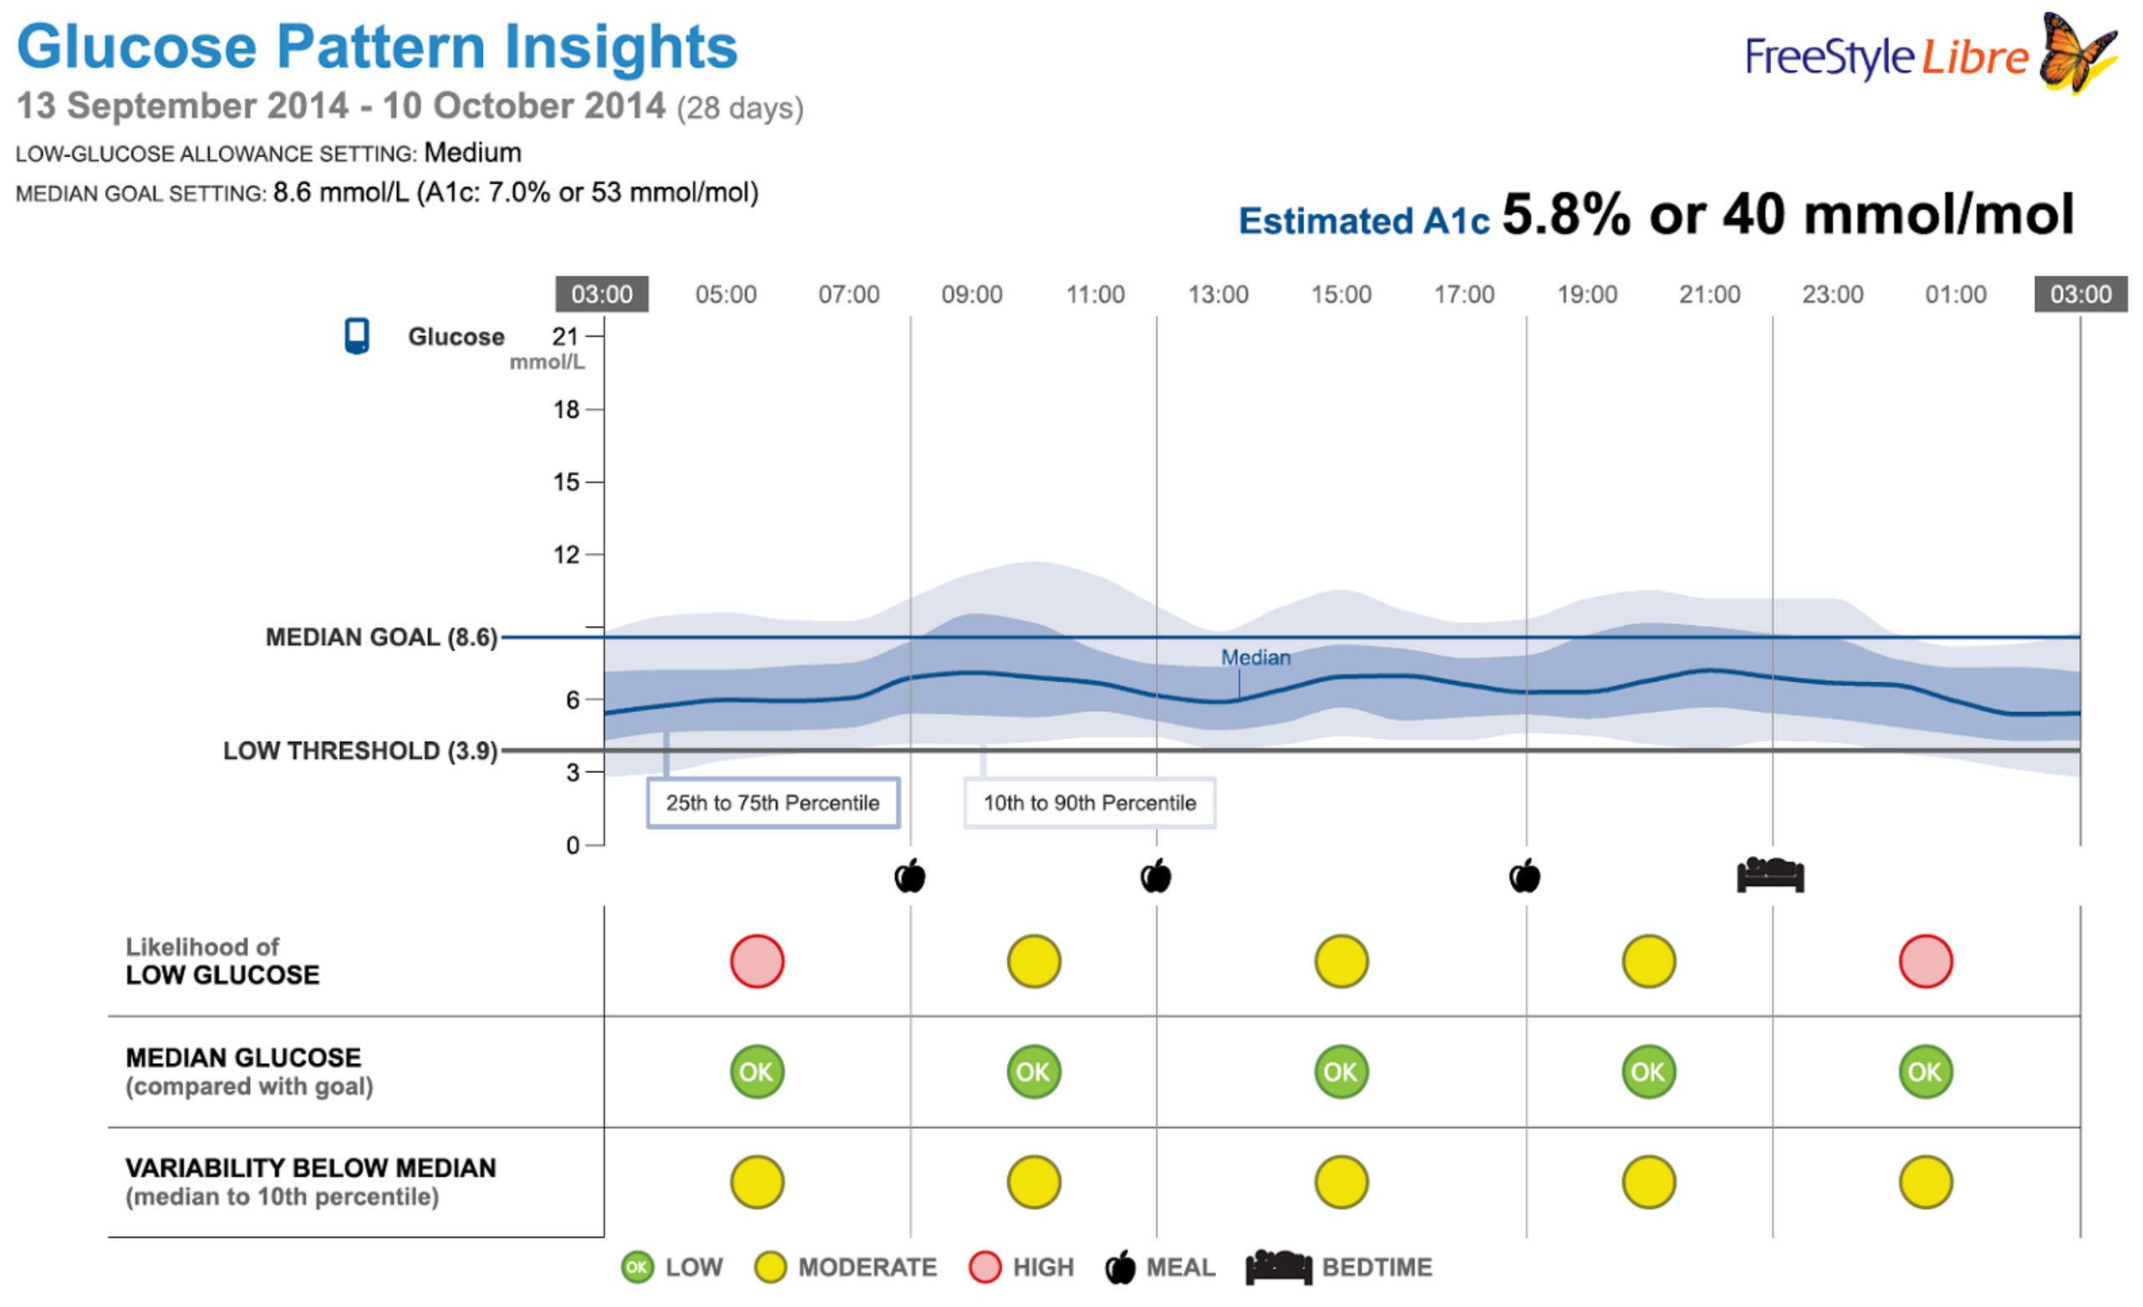
improved understanding of glycaemia leads to better decision making by patients and doctors
Notes:
8

Slide 9
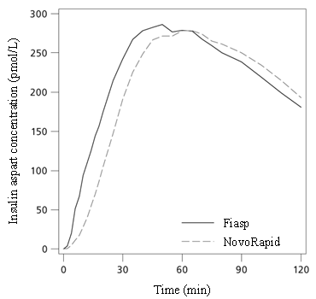
Type 1 diabetes: new insulins
faster acting short-acting insulins
reduce interval required pre-meal for dosing
quicker time to peak reduces post-prandial glucose
faster asparte (FIAsp)
x2 AUC in first 30 mins
faster onset of action
Notes:
9

Slide 10
Type 1 diabetes: new insulins
longer acting long-acting insulins
lower intra-individual variability of day-to-day action
less overnight hypoglycaemia
dose timing flexibility
? less DKA in intermittent insulin users
insulin glargine U300 (Tuojeo)
insulin degludec (Tresiba)
Notes:
10

Slide 11
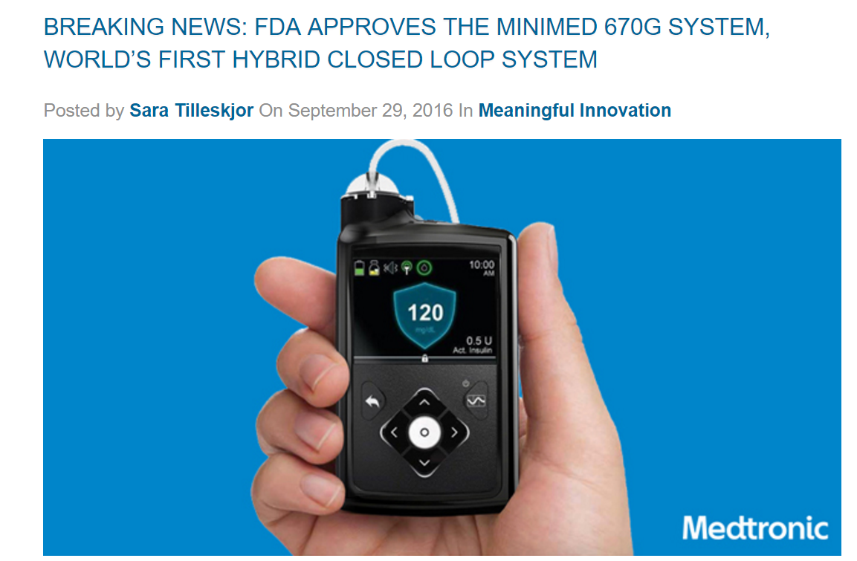
Type 1 diabetes: pump technologies
Medtronic 670G – FDA approved
Notes:
11

Slide 12
glucose sensing via CGMS
Hybrid Closed Loop
algorithm
manual entry:
CHO intake
insulin dose adjustment

Slide 13
glucose sensing via CGMS
Hybrid Closed Loop
algorithm
manual entry:
CHO intake
model / fuzzy logic based
no machine learning / AI element
insulin dose adjustment

Slide 14
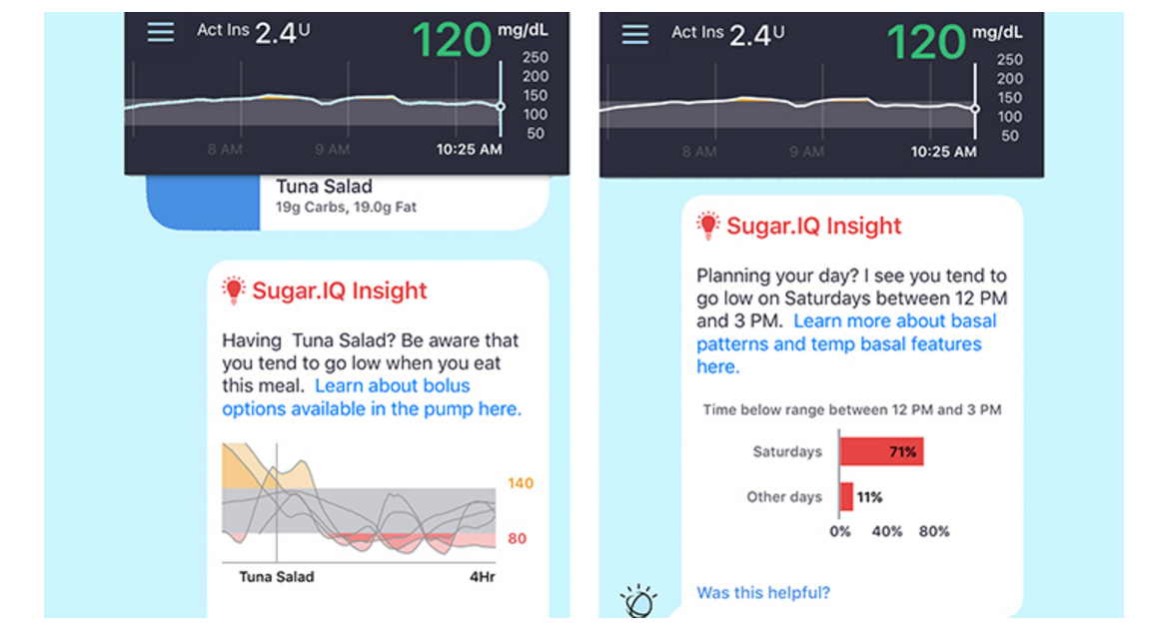
Type 1 diabetes: machine learning / AI
Medtronic / IBM Watson – sugar.IQ
pattern recognition using multiple data sources:
CBG / CGMS, accelerometer data, CHO / nutritional data, location, weather etc

Slide 15
Type 2 Diabetes
Notes:
15

Slide 16
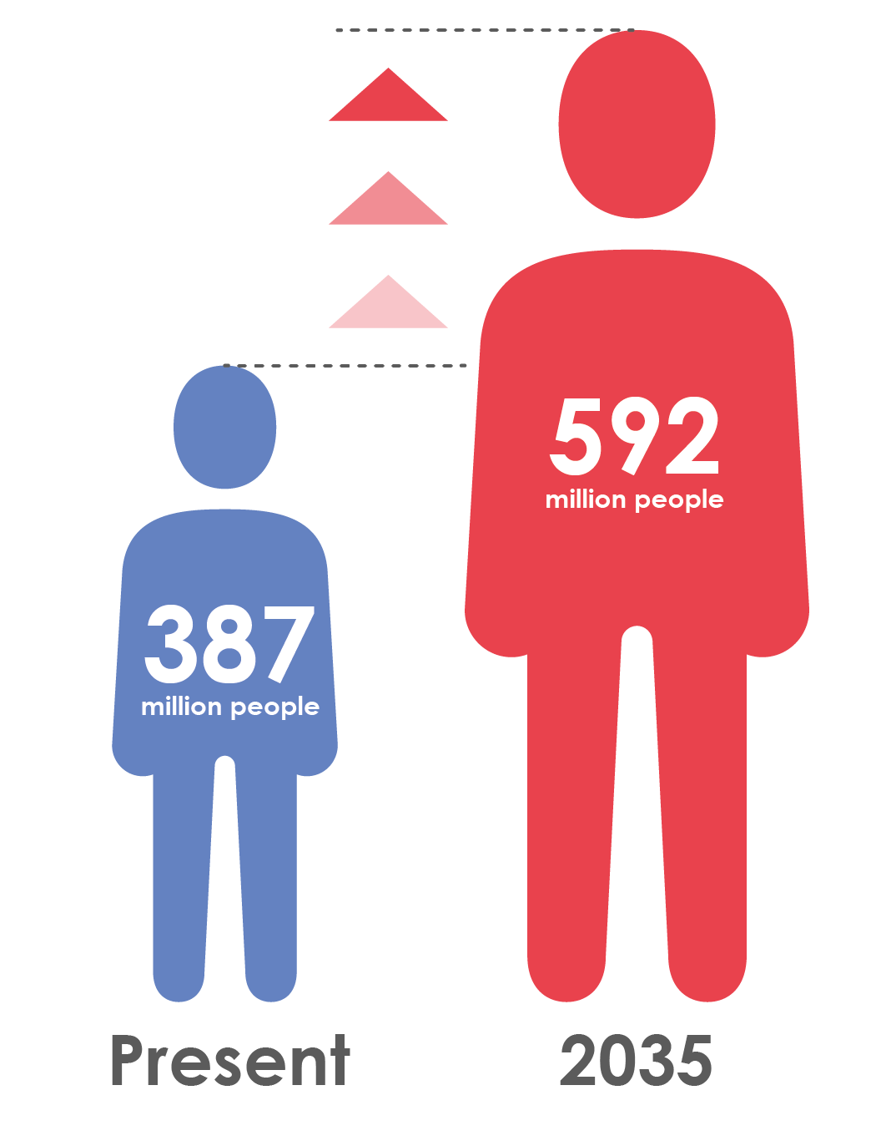
Type 2 diabetes is increasingly prevalent
Globally, 387 million people are living with diabetes¹
At least 68% of people >65 years with diabetes die of heart disease²
Mortality risk associated with diabetes (n=820,900)³
This will rise to 592 million by 2035¹
1. IDF Diabetes Atlas 6th Edition 2014 http://www.idf.org/diabetesatlas; 2. Centers for Disease Control and Prevention , National Diabetes Fact Sheet, 2011 Available at http://www.cdc.gov/diabetes/pubs/pdf/ndfs_2011.pdf; 3. Seshasai SRK et al. N Engl J Med 2011;364:829-41 Supplementary Appendix
Notes:
16

Slide 17
Diabetes is associated with significant loss of life years
Men
Women
7
6
5
4
3
2
1
0
Non-vascular deaths
Vascular deaths
7
6
5
4
3
2
1
0
Years of life lost
0
40
50
60
70
80
90
0
40
50
60
70
80
90
Age (years)
Age (years)
On average, a 50-year-old individual with diabetes and no history of vascular disease will die 6 years earlier compared to someone without diabetes
.
Seshasai SRK et al. N Engl J Med 2011;364:829-41
Notes:
17

Slide 18
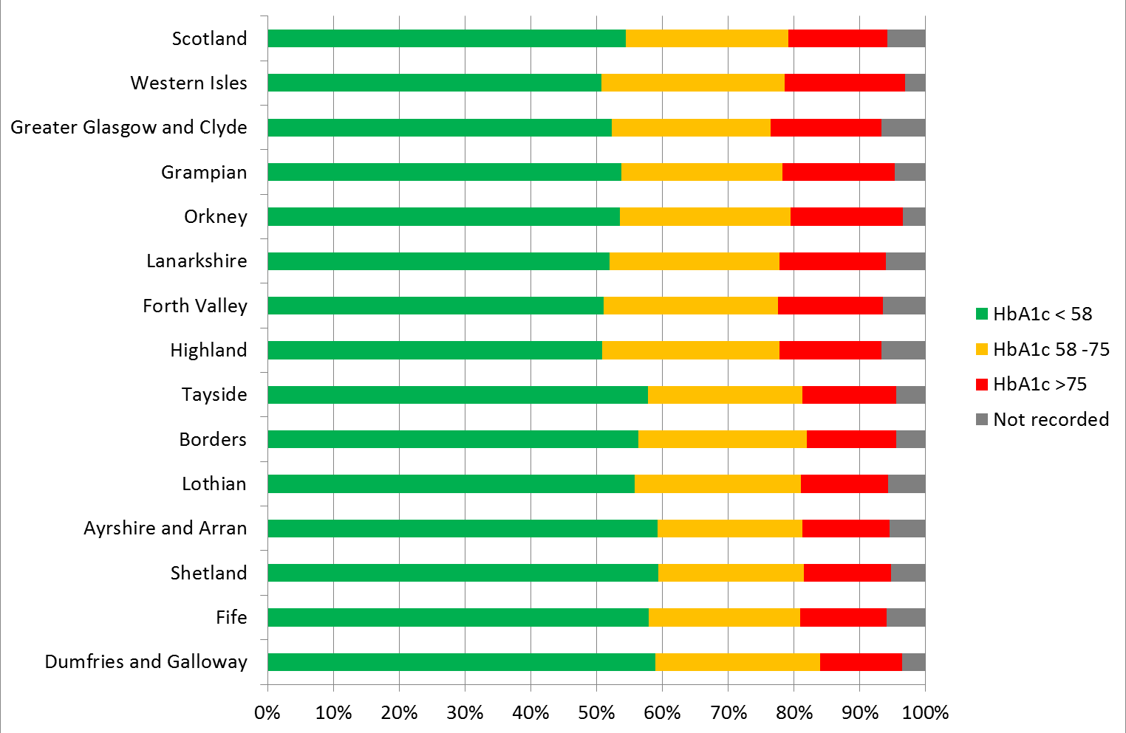
How well do we manage glycaemia in T2DM?
Scottish Diabetes Survey 2015
Number of Patients with Type 2 with HbA1c Controlled

Slide 19
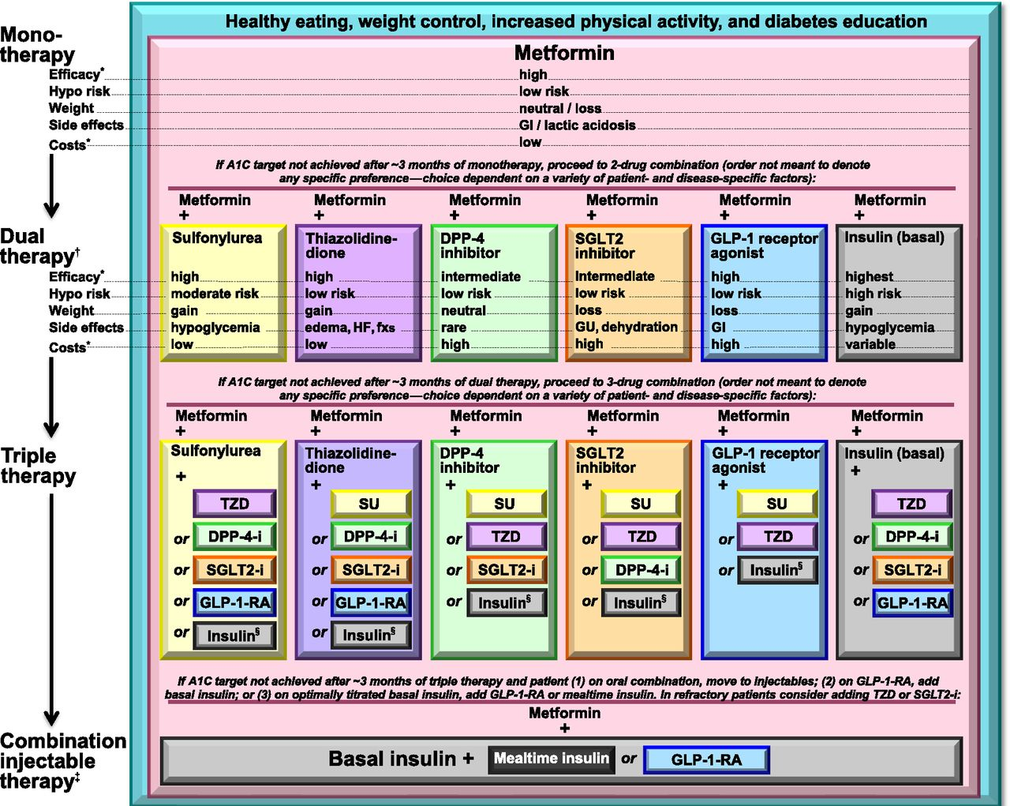

Antihyperglycemic therapy in type 2 diabetes: general recommendations (15).
American Diabetes Association Dia Care 2015;38:S41-S48
©2015 by American Diabetes Association
Notes:
Antihyperglycemic therapy in type 2 diabetes: general recommendations (15). The order in the chart was determined by historical availability and the route of administration, with injectables to the right; it is not meant to denote any specific preference. Potential sequences of antihyperglycemic therapy for patients with type 2 diabetes are displayed, with the usual transition moving vertically from top to bottom (although horizontal movement within therapy stages is also possible, depending on the circumstances). DPP-4-i, DPP-4 inhibitor; fxs, fractures; GI, gastrointestinal; GLP-1-RA, GLP-1 receptor agonist; GU, genitourinary; HF, heart failure; Hypo, hypoglycemia; SGLT2-i, SGLT2 inhibitor; SU, sulfonylurea; TZD, thiazolidinedione. *See ref. 15 for description of efficacy categorization. †Consider starting at this stage when A1C is ≥9%. ‡Consider starting at this stage when blood glucose is ≥300–350 mg/dL (16.7–19.4 mmol/L) and/or A1C is ≥10–12%, especially if symptomatic or catabolic features are present, in which case basal insulin + mealtime insulin is the preferred initial regimen. §Usually a basal insulin (NPH, glargine, detemir, degludec). Adapted with permission from Inzucchi et al. (15).

Slide 20
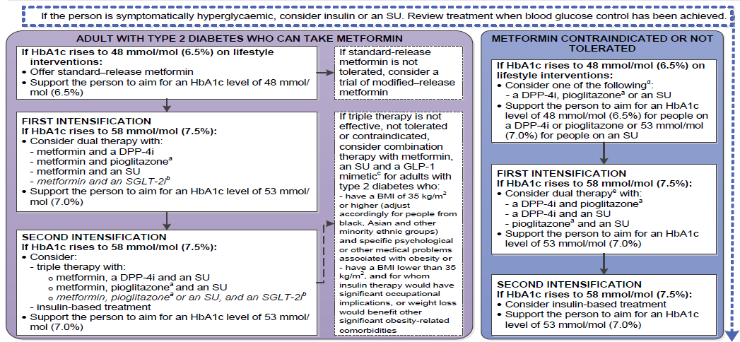
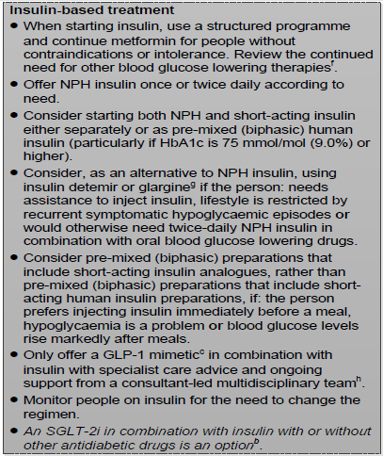
NICE NG28 – Algorithm for blood glucose lowering therapy in adults with type 2 diabetes
NICE updated its guidance for type 2 diabetes in Dec 2015 (NG28)
This sets an initial HbA1c target of 6.5%, with a target of 7.0% at further intensification steps with 3/6 month patient reviews
Adapted from NICE Guideline NG28 http://www.nice.org.uk/guidance/ng28/resources/algorithm-for-blood-glucose-lowering-therapy-in-adults-with-type-2-diabetes-2185604173 accessed 26th Jan 2016

Slide 21
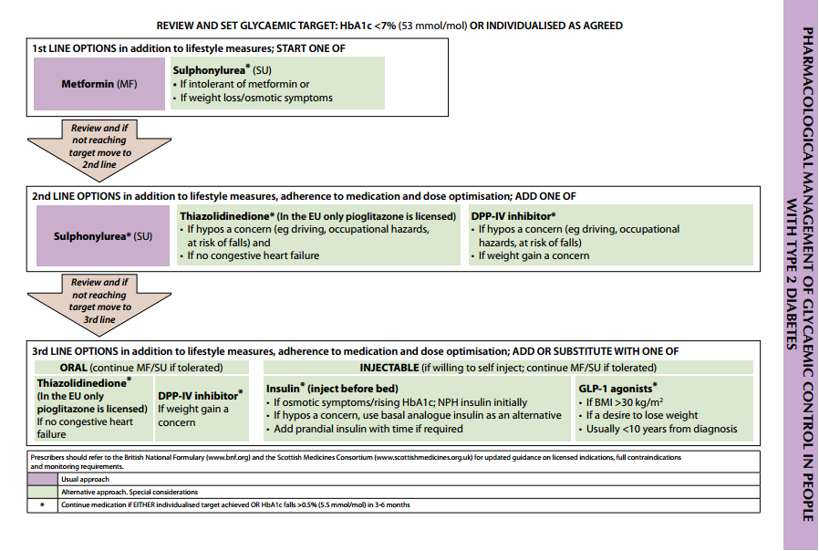
SIGN recommendations for pharmacological management of glycaemic control in people with T2D
Reference SIGN clinical guideline 116. Management of diabetes. March 2010 Available at: http://www.sign.ac.uk/guidelines/fulltext/116/ (accessed September 2014).
Notes:
Note to Dr Jones: Taken from SIGN guideline – we can leave as is if you think this should be recognisable or re-draw so it’s clearer to read.
21

Slide 22
NHS GGC Guidelines
http://ggcprescribing.org.uk/clinical-guidelines/

Slide 23
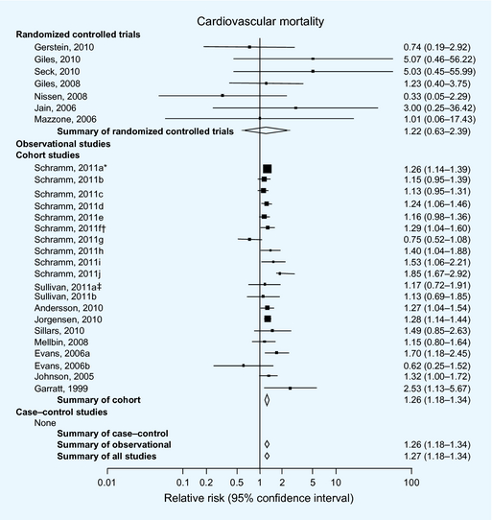
Sulphonylureas and risk of cardiovascular disease: systematic review and meta‐analysis
Diabetic Medicine Volume 30, Issue 10, pages 1160-1171, 16 SEP 2013 DOI: 10.1111/dme.12232 http://onlinelibrary.wiley.com/doi/10.1111/dme.12232/full#dme12232-fig-0002
Notes:
23
Meta‐analysis results of studies comparing sulphonylureas to non‐sulphonylurea on cardiovascular mortality. *Schramm 2011a–e were conducted in patients without prior myocardial infarction, evaluating glimepiride, gliclazide, glyburide, glipizide and tolbutamide vs. metformin,respectively. †Schramm 2011f–j were conducted in patients with prior myocardial infarction, evaluating glimepiride, gliclazide, glyburide, glipizide and tolbutamide vs. metformin,respectively. ‡Sullivan 2011a compared sulphonylurea with metformin. §Sullivan 2011b compared sulphonylurea with diet. ¶Evans 2006a compared sulphonylurea with metformin. **Evans 2006b compared combination sulphonylurea and metformin with metformin alone.
© This slide is made available for non-commercial use only. Please note that permission may be required for re-use of images in which the copyright is owned by a third party.

Slide 24
Glucose-lowering treatments and associated CV risk
Risk of cardiovascular mortality and non-fatal myocardial infarction
(6171 events)
Metformin
Sulphonylureas
Tolbutamide
Gliclazide
Glipizide
Glimepiride
Gilbenclamide
Insulin
0.8
1
1.2
1.4
1.6
1.8
Hazard Ratio (metformin reference = 1)
CV: cardiovascular
Adapted from Jørgensen CH, et al. Cardiovasc Diabetol 2010;9:54.
Notes:
24

Slide 25
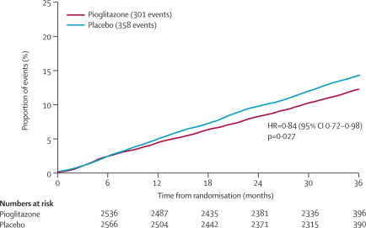
Secondary prevention of macrovascular events in patients with type 2 diabetes in the PROactive Study (PROspective pioglitAzone Clinical Trial In macroVascular Events): a randomised controlled trial
Figure 3. Kaplan-Meier curve of time to main secondary endpoint**Death from any cause, non-fatal myocardial infarction (excluding silent myocardial infarction), or stroke.
John A Dormandy et al
Lancet, Volume 366, Issue 9493, 2005, 1279–1289
http://dx.doi.org/10.1016/S0140-6736(05)67528-9

Slide 26
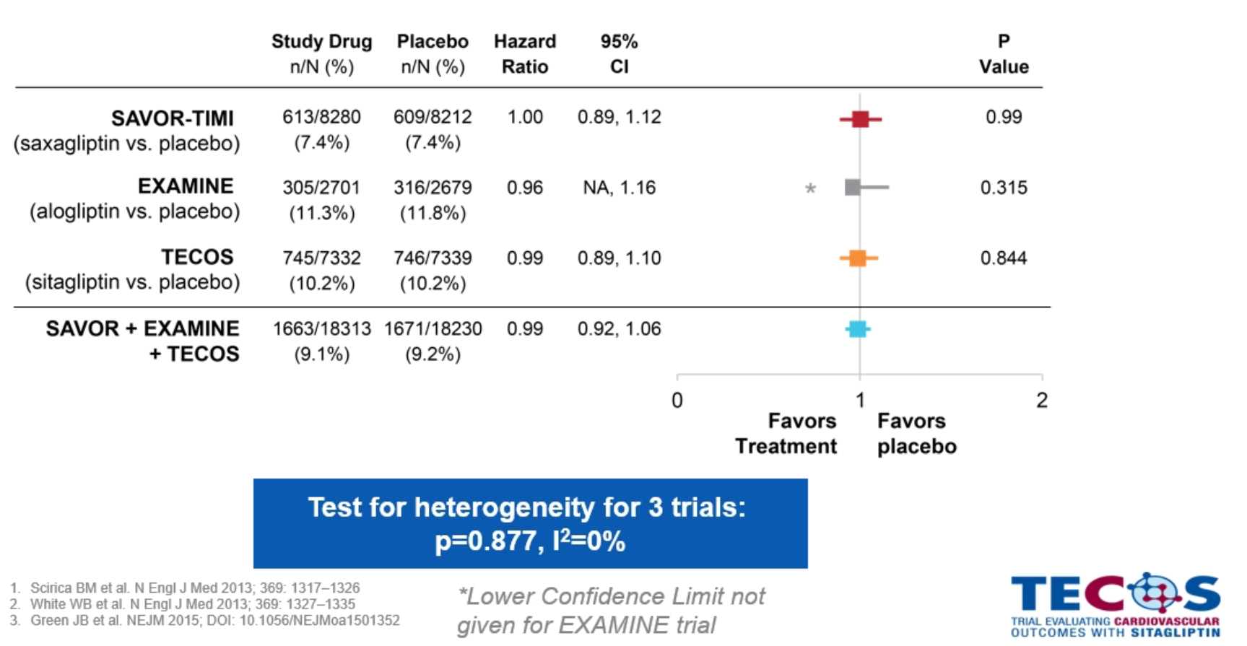
Cardiovascular safety studies (TECOS, EXAMINE, SAVOR-TIMI)

Slide 27
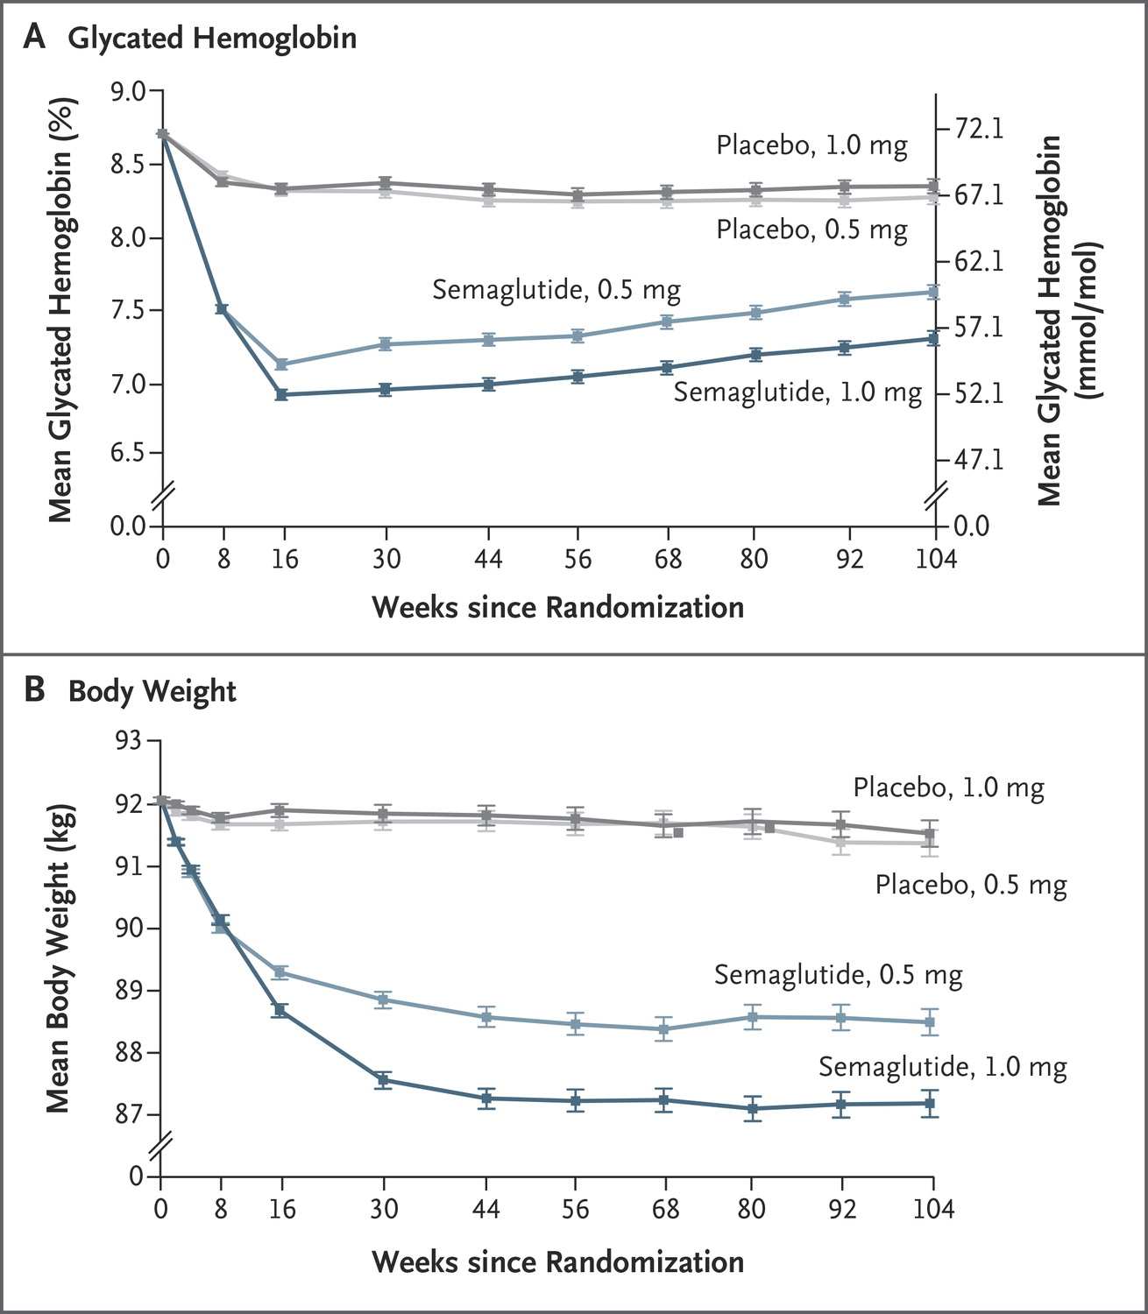
Semaglutide and Cardiovascular Outcomes in Patients with Type 2 Diabetes
SUSTAIN-6 Investigators
N Engl J Med, 2016

Slide 28
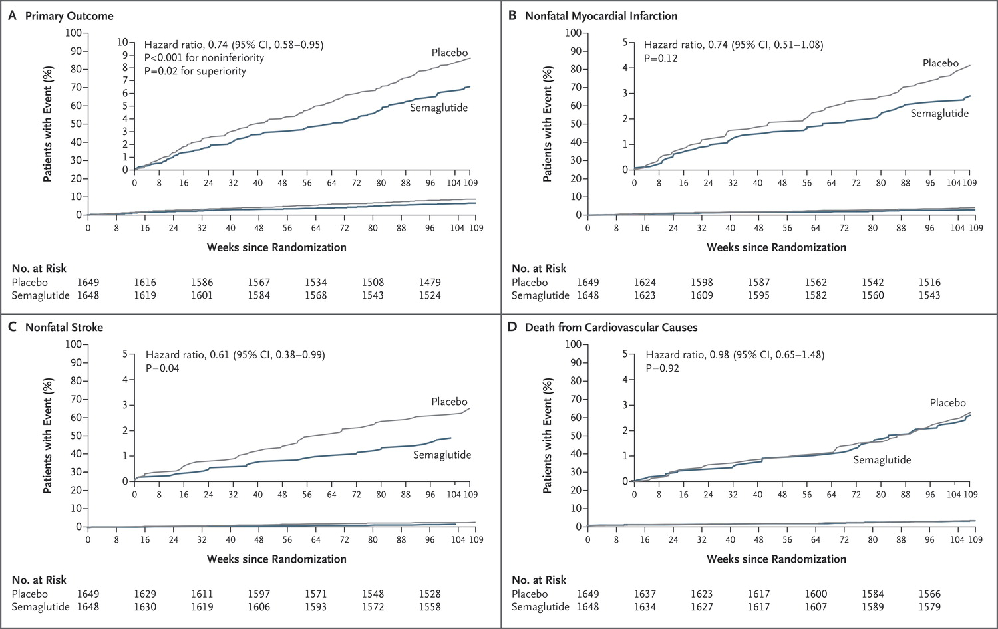
Semaglutide and Cardiovascular Outcomes in Patients with Type 2 Diabetes
SUSTAIN-6 Investigators
N Engl J Med, 2016

Slide 29
LEADER trial: Primary Outcome
First occurrence of CV death, nonfatal myocardial infarction, or nonfatal stroke in the time-to-event analysis in patients with type 2 diabetes and high CV risk.
Hazard ratio, 0.87 (95% CI, 0.78–0.97)
P<0.001 for noninferiority
P=0.01 for superiority
Patients with an event (%)
Placebo
Liraglutide
Months since randomisation
Liraglutide Effect and Action in Diabetes: Evaluation of cardiovascular outcome Results (LEADER) trial
Adapted from: Marso SP et al., NEJM 2016

Slide 30
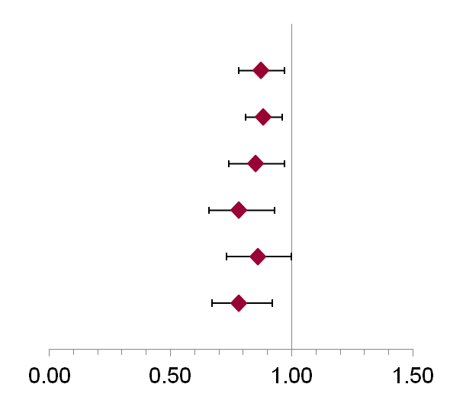
Liraglutide and Cardiovascular Outcomes in Type 2 Diabetes LEADER Trial Investigators N Engl J Med, 2016
LEADER
(N=9340)
 |  | Hazard ratio (95% CI) | P value
Primary composite endpoint* |  | 0.87 (0.78-0.97) | 0.01
Expanded composite endpoint† |  | 0.88 (0.81-0.96) | 0.005
Death from any cause |  | 0.85 (0.74-0.97) | 0.02
CV death |  | 0.78 (0.66-0.93) | 0.007
Fatal or nonfatal MI |  | 0.86 (0.73-1.00) | 0.046
Nephropathy |  | 0.78 (0.67-0.92) | 0.003
Favors liraglutide
*CV death, nonfatal MI (including silent MI), or nonfatal stroke; †CV death, nonfatal MI (including silent MI), nonfatal stroke, coronary revascularization, and hospitalization for unstable angina or HF.
CI, confidence interval; CV, cardiovascular; MI, myocardial infarction.
30

Slide 31
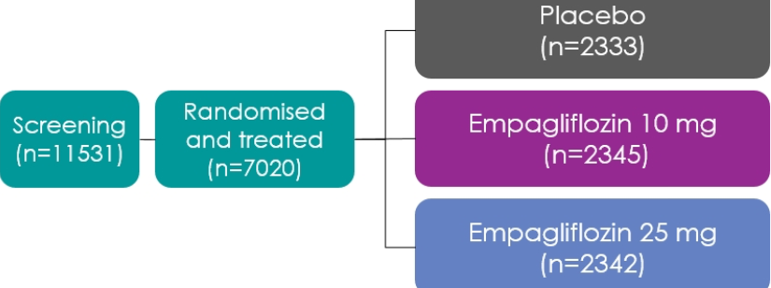
Empagliflozin, Cardiovascular Outcomes, and Mortality in Type 2 Diabetes Bernard Zinman et al, NEJM, 2015

Slide 32
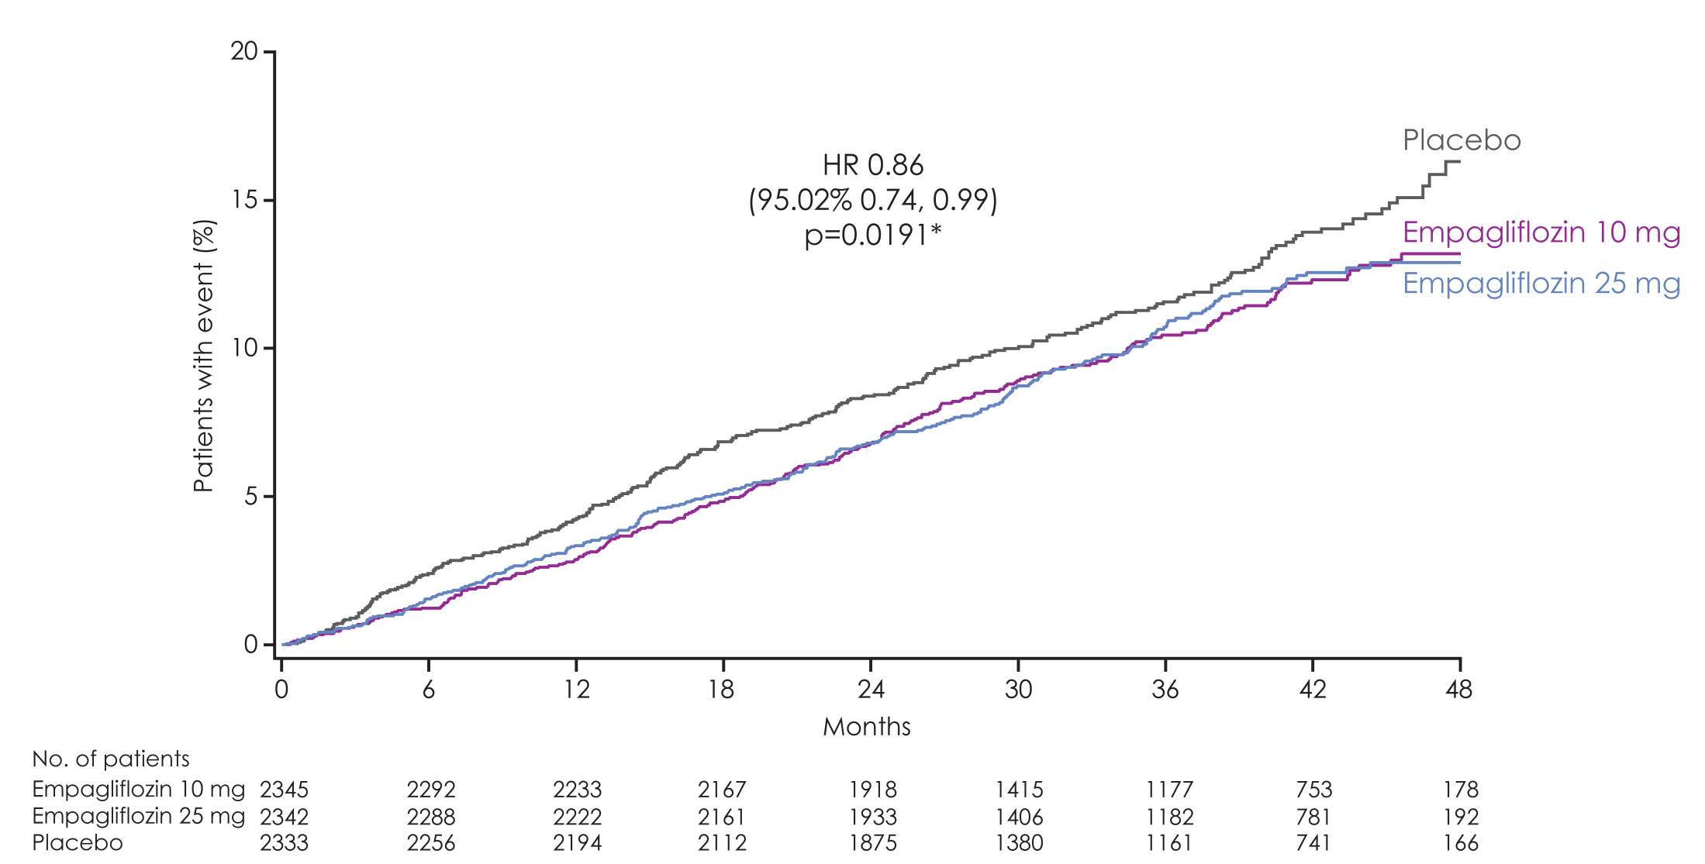
3-point MACE
Empagliflozin 10 mg
HR 0.85
(95% CI 0.72, 1.01)
p=0.07
Empagliflozin 25 mg
HR 0.86
(95% CI 0.73, 1.02)
p=0.09
Cumulative incidence function. MACE, Major Adverse Cardiovascular Event; HR, hazard ratio
Zinman B et al. N Engl J Med 2015 DOI: 10.1056/NEJMoa1504720 Supplementary Appendix
Notes:
32

Slide 33
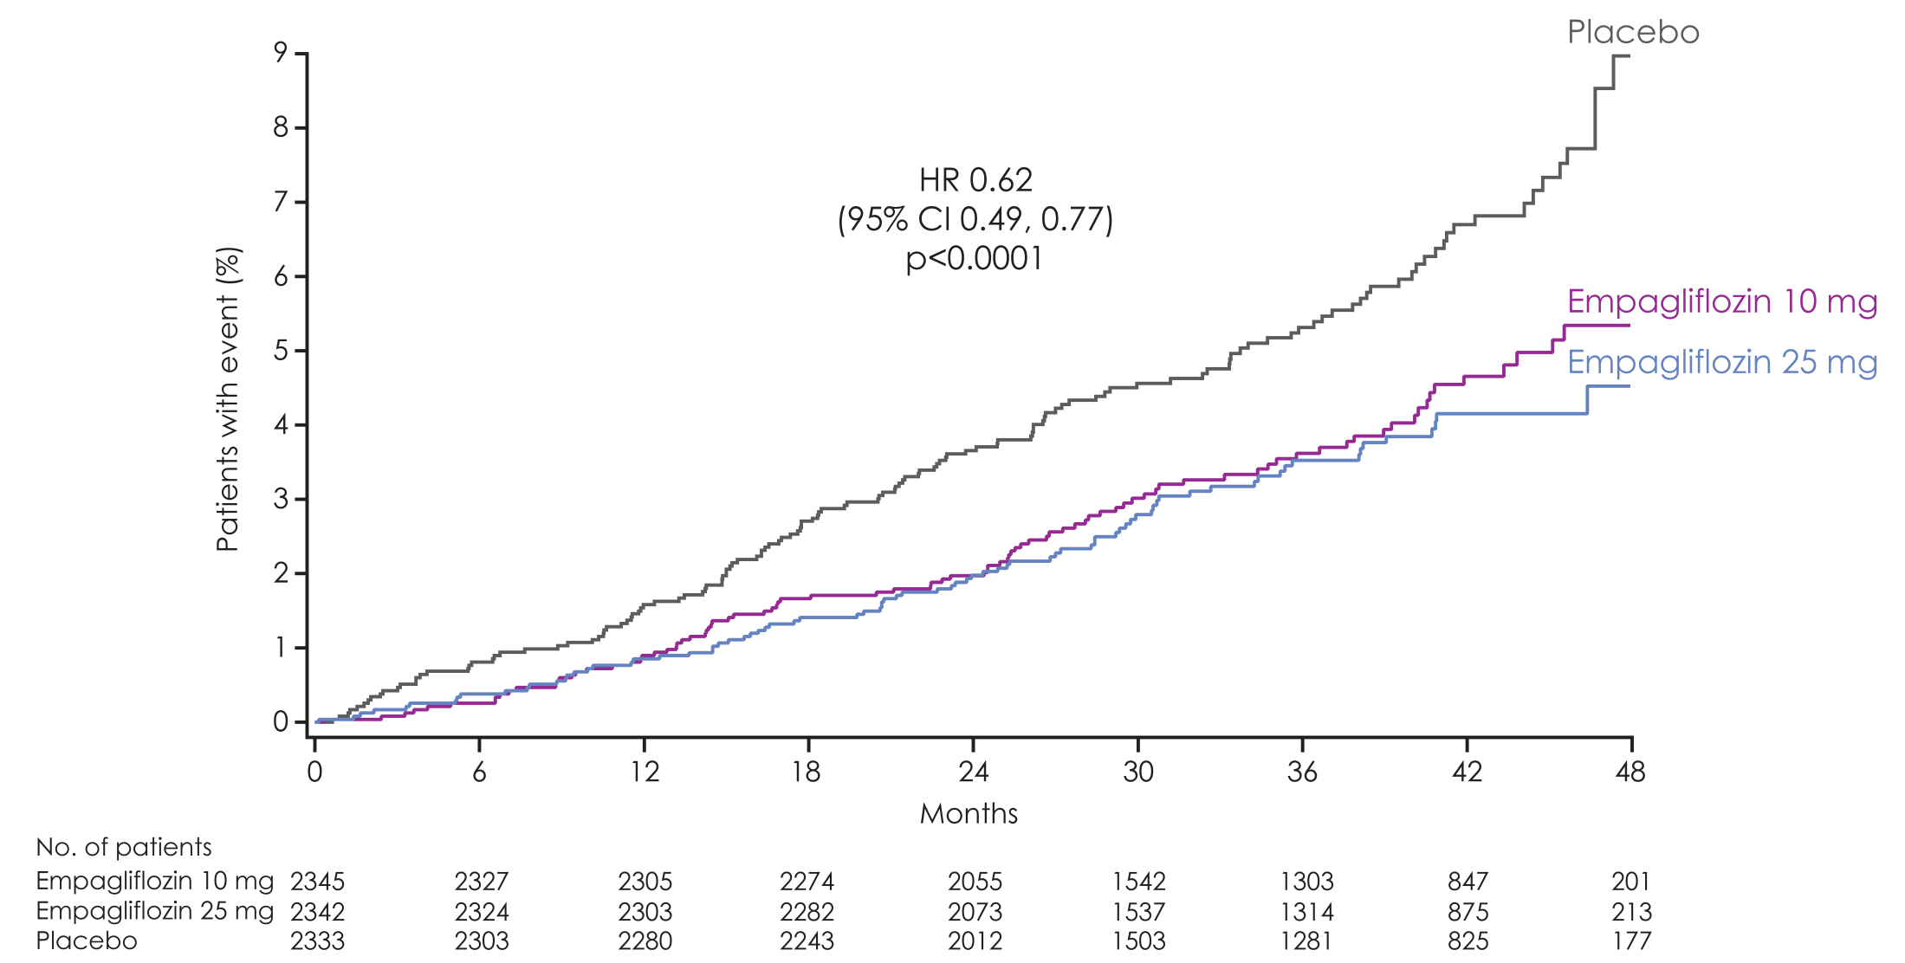
CV death
Empagliflozin 10 mg
HR 0.65
(95% CI 0.50, 0.85)
p=0.002
RRR: 35%
ARR: 2.1%
Empagliflozin 25 mg
HR 0.59
(95% CI 0.45, 0.77)
p=<0.001
RRR: 41%
ARR: 2.4%
Cumulative incidence function. HR, hazard ratio; RRR: Relative risk reduction; ARR; Absolute risk reduction; CER: Control Event Rate; EER: Experimental Event rate. ARR = CER – EER. Zinman B et al. N Engl J Med 2015 DOI: 10.1056/NEJMoa1504720 Supplementary Appendix
Notes:
33

Slide 34
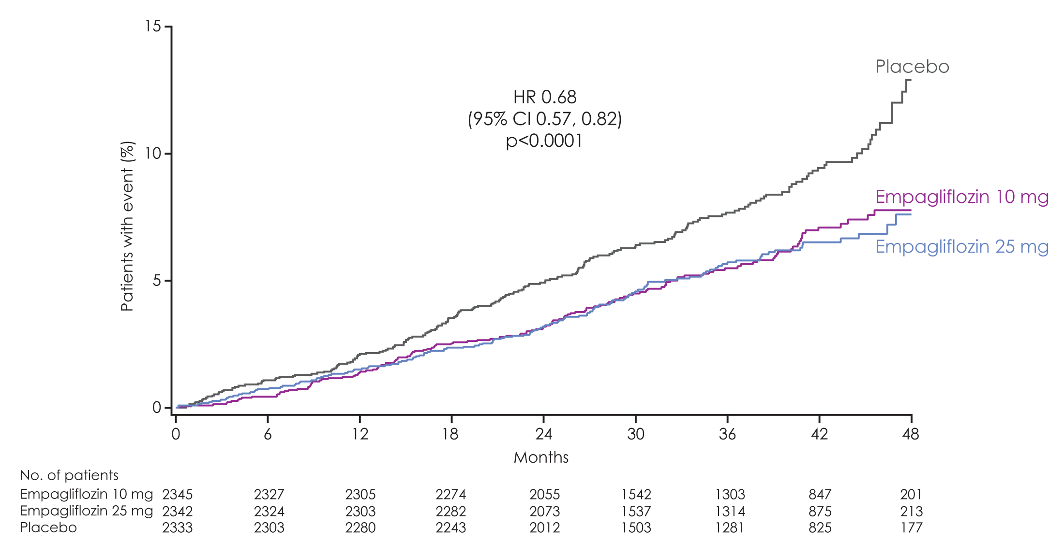
All-cause mortality
Empagliflozin 10 mg
HR 0.70
(95% CI 0.56, 0.87)
p=0.001
RRR: 30%
ARR: 2.5%
Empagliflozin 25 mg
HR 0.67
(95% CI 0.54, 0.83)
p=<0.001
RRR: 33%
ARR: 2.7%
HR 0.68
(95% CI 0.57, 0.82)
p<0.0001
Kaplan-Meier estimate. HR, hazard ratio; RRR: Relative risk reduction; ARR; Absolute risk reduction; CER: Control Event Rate;
EER: Experimental Event rate. ARR = CER – EER.
Zinman B et al. N Engl J Med 2015 DOI: 10.1056/NEJMoa1504720 Supplementary Appendix
Notes:
34

Slide 35
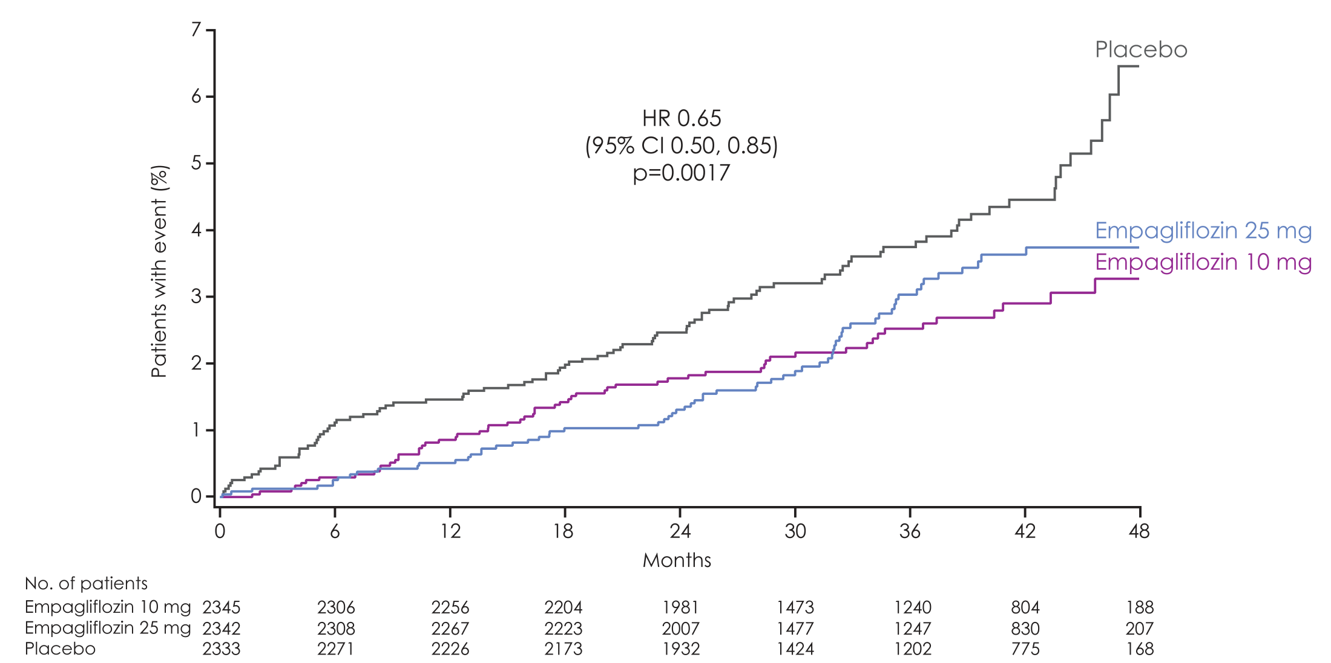
Hospitalisation for heart failure
Empagliflozin 10 mg
HR 0.62
(95% CI 0.45, 0.86)
p=0.004
RRR: 38%
ARR: 1.5%
Empagliflozin 25 mg
HR 0.68
(95% CI 0.50, 0.93)
p=0.02
RRR: 32%
ARR: 1.3%
Cumulative incidence function. HR, hazard ratio; RRR: Relative risk reduction; ARR; Absolute risk reduction; CER: Control Event Rate; EER: Experimental Event rate. ARR = CER – EER
Zinman B et al. N Engl J Med 2015 DOI: 10.1056/NEJMoa1504720 Supplementary Appendix
Notes:
35

Slide 36
Adverse events
 | Placebo (n=2333) |  | Empagliflozin 10 mg (n=2345) |  | Empagliflozin 25 mg (n=2342)
 | n (%) | Rate | n (%) | Rate | n (%) | Rate
One or more AEs | 2139 (91.7%) | 178.67 | 2112 (90.1%) | 150.34 | 2118 (90.4%) | 148.36
One or more drug-related* AEs | 549 (23.5%) | 11.33 | 666 (28.4%) | 14.15 | 643 (27.5%) | 13.38
One or more AEs leading to discontinuation | 453 (19.4%) | 8.26 | 416 (17.7%) | 7.28 | 397 (17.0%) | 6.89
One or more serious AEs | 988 (42.3%) | 22.34 | 876 (37.4%) | 18.20 | 913 (39.0%) | 19.39
Rate = per100 patient-years
*As reported by the investigator Patients treated with ≥1 dose of study drug
Zinman B et al. N Engl J Med 2015 DOI: 10.1056/NEJMoa1504720
Notes:
Notes:
The proportions of patients who had adverse events, serious adverse events, and adverse events leading to the discontinuation of a study drug were similar in the empagliflozin group and the placebo group.
36

Slide 37
Adverse events consistent with genital infection
 | Placebo (n=2333) |  | Empagliflozin 10 mg (n=2345) |  | Empagliflozin 25 mg (n=2342)
 | n (%) | Rate | n (%) | Rate | n (%) | Rate
Events consistent with genital infection | 42 (1.8%) | 0.73 | 153 (6.5%) | 2.66 | 148 (6.3%) | 2.55
Serious events | 3 (0.1%) | 0.05 | 5 (0.2%) | 0.08 | 4 (0.2%) | 0.07
Events leading to discontinuation | 2 (0.1%) | 0.03 | 19 (0.8%) | 0.32 | 14 (0.6%) | 0.23
By sex
Male | 25 (1.5%) | 0.60 | 89 (5.4%) | 2.16 | 77 (4.6%) | 1.78
Female | 17 (2.6%) | 1.09 | 64 (9.2%) | 3.93 | 71 (10.8%) | 4.81
Rate = per100 patient-years
Patients treated with ≥1 dose of study drug Based on 88 MedDRA preferred terms
Zinman B et al. N Engl J Med 2015 DOI: 10.1056/NEJMoa1504720
Notes:
37

Slide 38
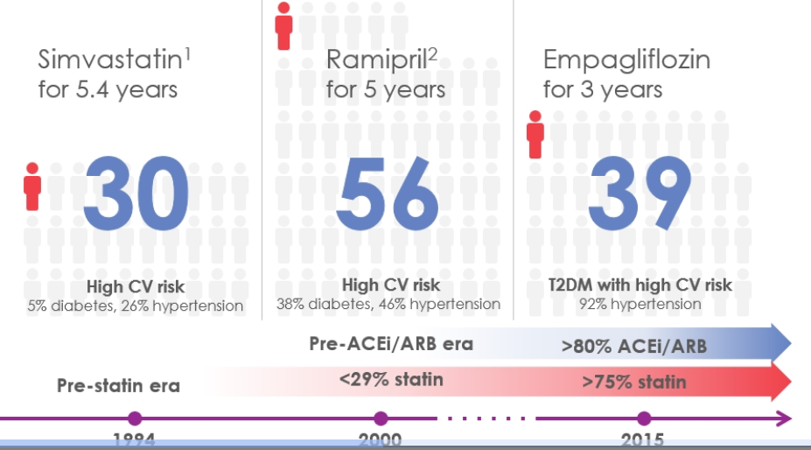
Numbers needed to treat comparison

Slide 39

Ms Green
45 yrs old
2 young children
Medical for new job found to have glycosuria
BMI 36
HbA1c after 7 months metformin 59 mmol/mol

Slide 40
Ms Green
What might the patients concerns be?
Is the HbA1c at target?
What would you do next?

Slide 41
Myocardial infarction and microvascular disease
80
60
Microvascular disease
Adjusted incidence per 1000 person years (%)
40
Myocardial infarction
20
0
0
5
6
7
8
9
10
11
Updated mean HbA_{1c} concentration (%)
A prospective observational study of 4585 patients recruited to the UKPDS study (whether randomised to treatment or not), of whom 3642 were included in analyses of relative risk iof microvascular or macrovasular complications. Adapted from Stratton IM, et al. BMJ 2000; 321: 405–412.
UKPDS 35. BMJ 2000; 321: 405-12

Slide 42

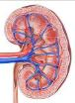



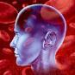
UKPDS: A 1% decrease in HbA_{1c} is associated with a reduction in complications
43%
Amputation or fatal peripheral blood vessel disease*
37%
Microvascular complications e.g. kidney disease and blindness *
HbA_{1C}
1%
21%
Deaths related to diabetes*
14%
Heart attack*
* p<0.0001
** p=0.035
12%
Stroke**
Stratton IM, et al. BMJ 2000; 321: 405–412.
Notes:
42

Slide 43
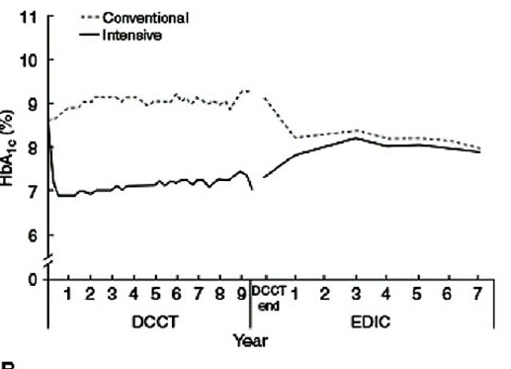
DCCT EDIC

Slide 44
UKPDS- Legacy Effect of Earlier Glucose Control
After median 8.5 years post-trial follow-up
Aggregate Endpoint 1997 2007
Any diabetes related endpoint RRR: 12% 9%
P: 0.029 0.040
Microvascular disease RRR: 25% 24%
P: 0.0099 0.001
Myocardial infarction RRR: 16% 15%
P: 0.052 0.014
All-cause mortality RRR: 6% 13%
P: 0.44 0.007
RRR = Relative Risk Reduction, P = Log Rank

Slide 45
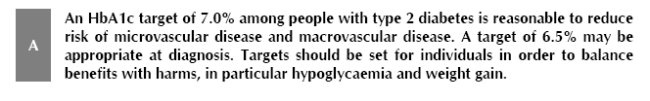
Scottish Intercollegiate Group Network Guideline Diabetes 2010

Slide 46
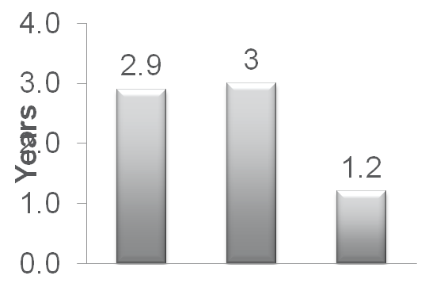
A Delay in Intensification May Result in Undue Glycaemic Burden
Data show it can take longer than 1 year for uncontrolled patients to receive additional therapy¹⁻³
Conservative Management of T2D⁴
Time to Add Additional Agent¹⁻³
+ Basal
insulin
Complex
injectable regimen
Mean A1C at intensification was 8.7%¹
Diet
+ Drug
+ Drug
10
Glycaemic burden equivalent to ~32 months of A1C 9%²
9
8
A1C (%)
NICE Goal
ADA/SIGN Goal⁵
7
AACE Goal⁶
6
Khunti et al. (N=50,476) Uncontrolled on 1 OAD
Nichols et al. (N=3891) Uncontrolled on MET+SU
Fu et al. (N=12,566) Uncontrolled on MET
Diagnosis
+5 years
+10 years
+15 years
^{T}2D=type 2 diabetes; ADA=American Diabetes Association; AACE=American Association of Clinical Endocrinologists; OAD=oral antidiabetic drug; MET=metformin; SU=sulfonylurea.
1. Khunti K et al. Diabetes Care. 2013;36:3411-3417. 2. Nichols GA et al. J Gen Intern Med. 2007;22:453-458. 3. Fu AZ et al. Diabetes Obes Metab. 2011;13:765-769. 4. Campbell IW. Br J Cardiol. 2000;7:625-631. 5. Inzucchi SE et al. Diabetes Care. 2015;38:140-149. 6. Garber AJ et al. Endocr Pract. 2015;21:e1-e10. doi:10.4158/EP15693.CS.
Notes:
Note to speaker: This slide animates.
Goal attainment may remain a challenge, since many health care practitioners take a conservative approach to the treatment of T2D, as depicted in the graph. Moreover, it has been shown that it may take 1.2 to 3 years for uncontrolled patients to receive additional treatment. These data serve to highlight that exposure to uncontrolled glycemia may be unnecessarily prolonged for patients with T2D, underscoring the need for a more proactive management approach.¹⁻⁵
Slide Background
In one study by Khunti et al, based on 81,573 people in the UK Clinical Practice Research Datalink from 2004 to 2006, for patients with a baseline A1C ≥7%, the median time to intensification with a second OAD, was 2.9 years.²
The Nichols study was based on 3891 patients with T2D identified from the Kaiser Permanente Northwest (KPNW), a not-for-profit, group-model health maintenance organization. These patients were being treated with metformin (MET)+SU at the time of initiation into the study, and despite being uncontrolled (A1C >7%), these patients continued for about 3 years without therapy escalation.³
Finally, a study by Fu et al, which included 12,566 adult patients with T2D on MET monotherapy and had at least one A1C measurement ≥7.0% or two fasting blood glucose measurements ≥126 mg/dL, the median time to treatment intensification with an additional OAD after MET failure was 1.2 years. These patients were identified in the GE database from 1997 to 2008.⁴
Campbell IW. Need for intensive, early glycaemic control in patients with type 2 diabetes. Br J Cardiol. 2000;7:625-631.
Khunti K, Wolden ML, Thorsted BL, Andersen M, Davies MJ. Clinical inertia in people with type 2 diabetes. Diabetes Care. 2013;36:3411-3417.
Nichols GA, Koo YH, Shah SN. Delay of insulin addition to oral combination therapy despite inadequate glycemic control. J Gen Intern Med. 2007;22:453-458.
Fu AZ, Qiu Y, Davies MJ, Radican L, Engel SS. Treatment intensification in patients with type 2 diabetes who failed metformin monotherapy. Diabetes Obes Metab. 2011;13:765-769.
Teoh H, Home P, Leiter LA. Should A1C targets be individualized for all people with diabetes? Diabetes Care. 2011;34:S191-S196.
46

Slide 47
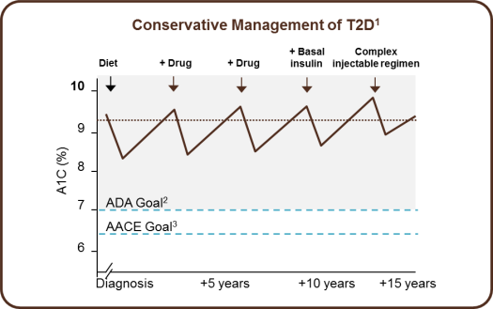
An Early Proactive Approach May Prevent the Prolonged Hyperglycaemia Associated With Delayed Incremental Treatment
Diet
Conservative Management of T2D¹
Oral agents monotherapy
+ Basal
insulin
Complex
injectable regimen
10
Diet
+ Drug
+ Drug
10
Oral agents combinations
Oral agents up-titration
9
9
Oral agents + Injectable therapy
Oral agents + multiple daily insulin injections
8
8
A1C (%)
A1C (%)
ADA Goal, NICE NG28 Intensification goal⁵
7
7
ADA Goal²
AACE Goal³
6
AACE Goal, NICE NG28 initial goal⁵
6
Duration of Diabetes⁴
Diagnosis
+5 years
+10 years
+15 years
T2D=type 2 diabetes; ADA=American Diabetes Association; AACE=American Association of Clinical Endocrinologists. NICE=National Institute for Health and Care Excellence
1. Campbell IW. Br J Cardiol. 2000;7:625-631. 2. Inzucchi SE et al. Diabetes Care. 2015;38:140-149 3. Garber AJ et al. Endocr Pract. 2015;21:e1-e10. doi:10.4158/EP15693.CS. 4. Adapted From Del Prato et al. Int J Clin Pract. 2005;59:1345-1355.5. NICE Guideline NG28 http://www.nice.org.uk/guidance/ng28/resources/algorithm-for-blood-glucose-lowering-therapy-in-adults-with-type-2-diabetes-2185604173 accessed 26th Jan 2016
Notes:
Note to speaker: This slide animates. The Conservative Management of T2D table is replaced with the graph depicting A1C level vs duration of diabetes.
Many health care practitioners take a conservative approach to treatment of T2D, as depicted in the graphic. A conservative incremental treatment approach may lead to prolonged hyperglycemia and a delay in needed treatment progression. Utilizing an early proactive approach to T2D management may help to attain glycemic goals quickly, thereby reducing the excess glycemic burden.¹
Slide Background:
In a study by Fu et al, which included 12,566 adult patients with T2D on metformin monotherapy who had at least one A1C measurement ≥7.0% or two fasting blood glucose measurements ≥126 mg/dL, the median time to treatment intensification with an additional drug after metformin failure was 1.2 years. These patients were identified in the GE database from January 1, 1997 to December 31, 2008.
Results: Of the 12,566 patients identified, mean age at index date was 63 years and 51% were female. Mean index A1C was 8.0% overall, with 66%, 19%, and 15% of patients having an index A1C of 7% to <8%, 8% to <9% and ≥9%, respectively. Median time to treatment intensification was 14.0 months overall and 19.0 months, 8.7 months and 4.5 months for patients with index A1C of 7% to <8%, 8% to <9%, and ≥9%, respectively. Factors associated with treatment intensification included higher index A1C, younger age, higher Charlson comorbidity index, metformin daily dose ≥1500 mg, and later index date (all P<0.05).
1. Lovshin JA, Zinman B. Clinical inertia—a barrier to effective management of T2DM. Nat Rev Endocrinol. 2013;9:635-636.
2. Fu AZ, Qiu Y, Davies MJ, Radican L, Engel SS. Treatment intensification in patients with type 2 diabetes who failed metformin monotherapy. Diabetes Obes Metab. 2011;13:765-769.
47

Slide 48
Learning Point
In younger type 2 diabetes at diagnosis we should consider tighter control and avoid treatment inertia

Slide 49
NHS GGC Guidelines
http://ggcprescribing.org.uk/clinical-guidelines/

Slide 50


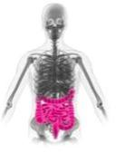
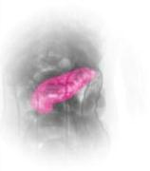

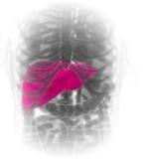
Role of the incretins in glucose homeostasis
Insulin¹
↑insulin biosynthesis and secretion
↑ β-cell proliferation
↑ β-cell survival
Glucose utilisation by muscle and adipose tissue²
GLP-1
Blood
Glucose
GIP
Food intake
Intestine
Pancreas
Glucagon¹
↓glucagon secretion from α-cells
Blood glucose increases
Hepatic glucose production²
GLP-1: glucagon like peptide 1; GIP: gastric inhibitory polypeptide.
1. Adapted from Drucker DJ. J Clin Invest 2007;117:24–32.
2. Adapted from Drucker DJ. Cell Metab. 2006;3:153–165.

Slide 51
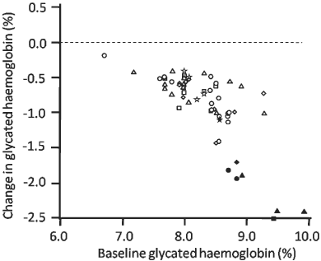
Dipeptidyl peptidase‐4 inhibitors in the treatment of type 2 diabetes: a comparative review
Diabetes, Obesity and Metabolism Volume 13, Issue 1, pages 7-18, 28 NOV 2010 DOI: 10.1111/j.1463-1326.2010.01306.x http://onlinelibrary.wiley.com/doi/10.1111/j.1463-1326.2010.01306.x/full#f3
Notes:
51
HbA1c lowering efficacy of dipeptidyl peptidase (DPP)‐4 inhibitors in relation to baseline HbA1c levels, as monotherapy or add‐on therapy (open symbols) or initial combination therapy (closed symbols) in studies of ≥12 weeks duration (see Appendix for references). Triangle, sitagliptin (100 mg qd); circle, vildagliptin (50 mg bid or 100 mg qd); square, saxagliptin (5 mg qd); diamond, alogliptin (25 mg qd) and star, linagliptin (5 mg qd).
© This slide is made available for non-commercial use only. Please note that permission may be required for re-use of images in which the copyright is owned by a third party.

Slide 52
HbA_{1c} reductions associated with the DPP-4 class versus other glucose lowering agents
Mean difference
(95% Cl)
Monotherapy: DPP-4 inhibitor vs metformin
Combined with metformin: DPP-4 inhibitor vs sulphonylurea
Combined with metformin: DPP-4 inhibitor vs pioglitazone
Combined with metformin: DPP-4 inhibitor vs GLP-1 agonist
-1
-0.5
0
0.5
1
Favours
DPP-4 inhibitor
Favours
active comparator
Meta-analysis of 19 studies comparing efficacy of sitagliptin, vildagliptin, linagliptin and saxagliptin (as a class) with metformin, sulphonylureas, pioglitazone and GLP-1 agonists.
DPP-4: dipeptidyl peptidase 4; GLP-1: glucagon-like peptide 1.
Adapted from Karagiannis T, et al. BMJ. 2012; 344:e1369.
Notes:
This slide shows that in T2D (type 2 diabetes) patients who do not achieve glycaemic control on metformin alone, DPP-4 inhibitors can lower HbA_{1c} in a similar way to sulfonylureas or pioglitazone.
Compared with metformin monotherapy, DPP-4 inhibitors were associated with a smaller decline in HbA_{1c} and a lower chance of attainment of the HbA_{1c} goal of less than 7%. As a second line treatment, DPP-4 inhibitors achieved a smaller decline in HbA_{1c} than the other hypoglycaemic drugs.
When data were analysed separately for each type of active comparator, DPP-4 inhibitors were less effective than sulfonylureas in reducing HbA_{1c}. There was no difference in the change in HbA_{1c} achieved between DPP-4 inhibitors and pioglitazone. Finally, DPP-4 inhibitors were inferior to GLP-1 agonists both in reducing HbA_{1c} and in achieving the glycaemic goal of less than 7%.
52

Slide 53
“Real-Life” Experience in Use of Dipeptidyl Peptidase 4 Inhibitors at a Large Scottish Teaching Hospital. Brown AL, Jones GC. British Journal of Diabetes and Vascular Disease, 2014.
Aims
Response of HbA1c and weight
Renal monitoring
Appropriateness of dose used
Methods
Retrospective analysis of SCI-DC database/clinical portal
June 2006 -June 2012
Microsoft excel spreadsheet

Slide 54
Hospital clinic patients glycaemic control at initiation and follow-up while on DPP4 inhibitor therapy and observed glycaemia response
 | Patients included n (%) | Mean HbA1c (mmolmol⁻¹⁾) (SD) | Range Med (range) | Mean change in HbA1c | CI | P value
Total patients | 264
HbA1c at Initiation | 263 (99.6) | 76 (15) | 73 (45-141)
HbA1c at follow-up (all patients) | 215 (81.4) | 68 (17.4) | 64 (33-131) | -7.9 n = 215 | -10 , -5.8 | >0.005
HbA1c at follow-up (DPP4 inhibitor addition only) | 192 (72.7) | 67 (17.2) | 64 (33-131) | -8.8 | -10.8, -6.7 | >0.005

Slide 55
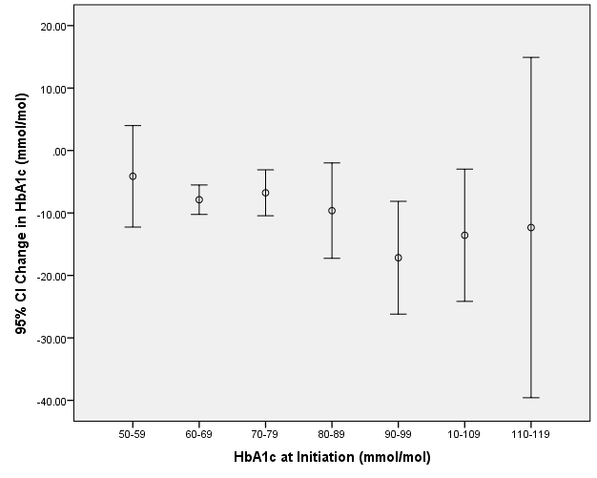
Glycaemic Response to DPP4 Inhibitor Therapy According to HbA1c at initiation.

Slide 56
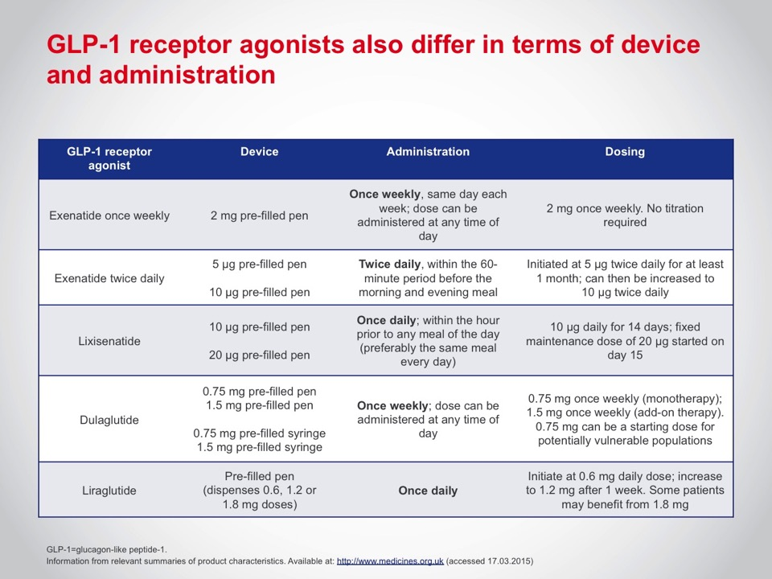
Notes:
Main talking point: Another area in which there is significant practical heterogeneity within the GLP-1 receptor agonist class is that of the dosing device and administration protocol.
56

Slide 57

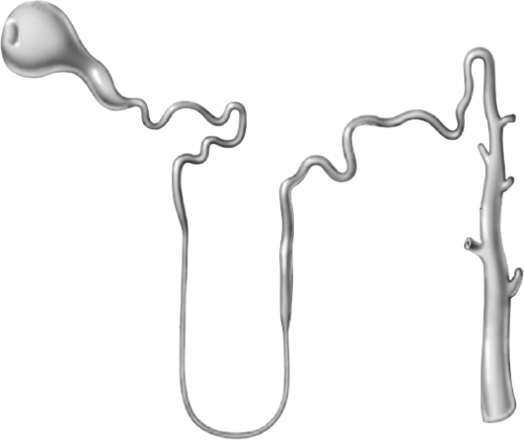

Renal glucose re-absorption under healthy conditions^{1,2}
Filtered glucose load 180 g/day
SGLT2
Virtually all of the filtered glucose is re-absorbed in the proximal tubules through SGLT2 and SGLT1 with SGLT2 accounting for ~ 90% in the S1 and S2 segments and SGLT1 accounting for ~ 10% in the S3 segment
~ 90%
In healthy individuals, the renal glomeruli filter ~180 g of glucose per day
SGLT1
~ 10%
SGLT, sodium glucose co-transporter.
References
1. Adapted from: Gerich JE. Diabet Med. 2010;27:136–142.
2. Bakris GL et al. Kidney Int. 2009;75;1272–1277.

Slide 58
SGLT2 inhibitors: therapeutic indications
 | Empagliflozin¹ | Canagliflozin² | Dapagliflozin³
Monotherapy | ü | ü | ü
In combination with other glucose-lowering products including insulin | ü | ü | ü (except pioglitazone)
Available doses | 10 mg od 25 mg od | 100 mg od 300 mg od | 10 mg od
*When diet and exercise alone do not provide adequate glycaemic control in patients for whom use of metformin is considered inappropriate due to intolerance.
References
1. Jardiance ® (empagliflozin) summary of product characteristics.
2. Invokana® (canagliflozin) Summary of Product Characteristics. Available at: http://www.medicines.org.uk/emc/medicine/28400 (accessed August 2014).
3. Forxiga® (dapagliflozin) Summary of Product Characteristics. Available at: http://www.medicines.org.uk/emc/medicine/27188 (accessed August 2014).

Slide 59
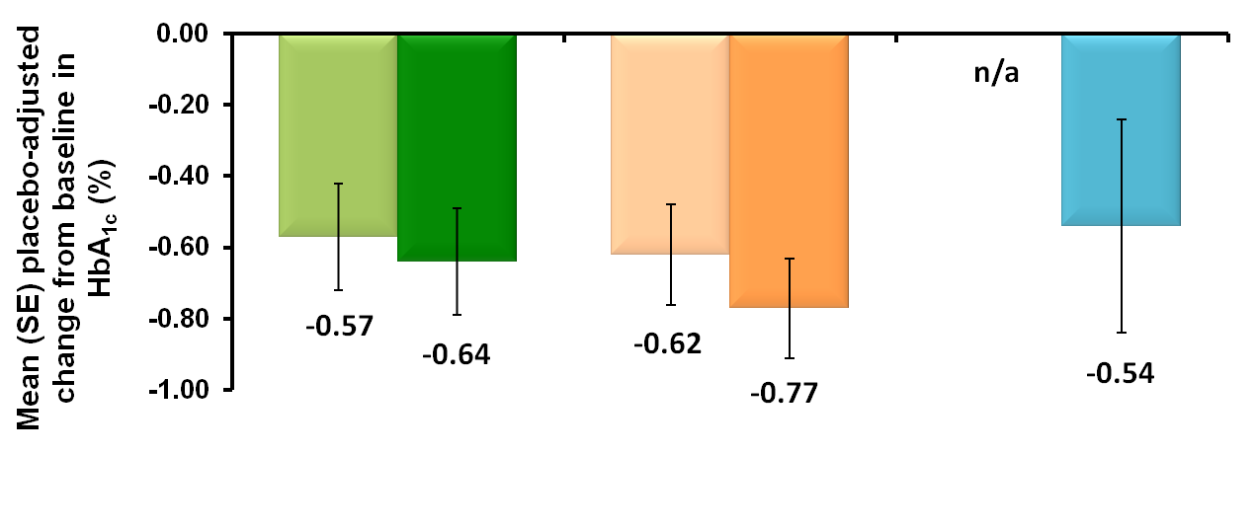
HbA_{1c} reduction: SGLT2 inhibitor add on to metformin indirect SPC comparison There are no head-to-head studies comparing SGLT2 inhibitors
Empagliflozin + MET
10 mg 25 mg
Canagliflozin
+ MET
100 mg 300 mg
Dapagliflozin
+ MET
5 mg* 10 mg
Patients, n | 217 | 213 |  | 368 | 367 |  | n/a | 135
Baseline HbA_{1c}, % | 7.94 | 7.86 |  | 7.94 | 7.95 |  | n/a | 7.92
All values are placebo correct, all trials are 24-26 weeks’ duration.
*Clinical studies for dapagliflozin only report outcomes for 10 mg. As per the SPC, it is recommended that 5 mg is the recommended dose for certain populations.
BL, baseline; MET, metformin; SE, standard error
References
1. Jardiance® (empagliflozin) Summary of Product Characteristics.
2. Invokana® (canagliflozin) Summary of Product Characteristics. Available at: http://www.medicines.org.uk/emc/medicine/28400 (accessed August 2014).
3. Forxiga® (dapagliflozin) Summary of Product Characteristics. Available at: http://www.medicines.org.uk/emc/medicine/27188 (accessed August 2014).
Notes:
Note to Dr Jones: Please highlight that there are no head-to-head studies comparing the SGLT2 inhibitors. These data reporting efficacy for empagliflozin, canagliflozin and dapagliflozin as add-on to metformin have been illustrated given the patient case study being discussed.
59
Doc ID

Slide 60
Retrospective review SCI-DC
GGC and Highland Health Boards
521 T2DM initiated dapagliflozin as part of routine care in accordance with the licensed indications.
54% male
Mean age 57.5 yrs

Slide 62
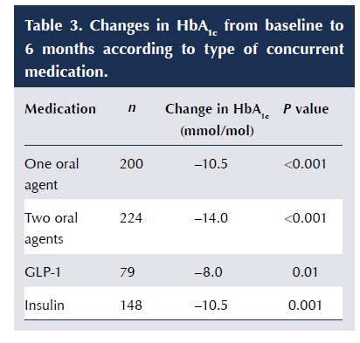

Slide 64

Mr White
54 yrs old
Routine diabetes check
Teacher
MI stents 3 years ago
DM2 years
BMI 35
HbA1c 73
eGFR >60

Slide 65
Mr White
What might the patients concerns be?
Is the HbA1c at target?
What would you do next?

Slide 66
STENO-2 – multifactorial intervention is key
Intensive therapy
Conventional therapy
100
Cumulative incidence of death (%)
80
P=0.35
P=0.005
P=0.14
80
60
P=0.02
Patients (%)
60
Conventional therapy
40
40
P=0.27
20
P=0.31
20
Intensive therapy
0
Glycated hemoglobin <6.5%
Cholesterol <175 mg/dl
Triglycerides <150 mg/dl
Systolic blood pressure <130 mm Hg
Diastolic blood pressure <80 mm Hg
0
0
1
2
3
4
5
6
7
8
9
10
11
12
13
Years of follow-up
Intensive therapy
Conventional therapy
Cumulative incidence of any cardiovascular event (%)
80
No of cardiovascular events
40
P<0.001
Conventional therapy
60
30
40
20
20
Intensive therapy
10
0
0
0
1
2
3
4
5
6
7
8
9
10
11
12
13
Death from cardiovascular causes
Stroke
Myocardial infarction
CABG
PCI
Revas- cularization
Amputation
Years of follow-up
Reference
Copied from; Gaede P et al. NEJM. 2008;358:580–91.
Notes:
66

Slide 67
Impact of intensive therapy for diabetes: Summary of major clinical trials
Study | Microvascular risk |  | Macrovascular risk |  | Mortality
UKPDS^{1,2} | ⬇ | ⬇ | ⬅➔ | ⬇ | ⬅➔ | ⬇
ACCORD^{3,4} | -* |  | ⬅➔ |  | ⬆
ADVANCE⁵ | ⬇ |  | ⬅➔ |  | ⬅➔
VADT⁶ | ⬇^{ǂ} |  | ⬅➔ |  | ⬅➔
Initial trial
Post trial monitoring phase
ACCORD=Action to Control Cardiovascular Risk in Diabetes; ADVANCE=Action in Diabetes and Vascular Disease: Preterax and Diamicron MR Controlled Evaluation; UKPDS=UK Prospective Diabetes Study; VADT = Veterans Affairs Diabetes Trial.
*Not studied.
ǂSignificant benefit was observed only for progression of albuminuria.
1. UK Prospective Diabetes Study (UKPDS) Group. Lancet 1998;352:837–853. 2. Holman RR, et al. N Engl J Med 2008;359:1577–1589. 3. Ismail-Beigi F, et al. Lancet 2010;376:419–430.
4. ACCORD Study Group, et al. N Engl J Med 2008;358:2545–2559. 5. ADVANCE Collaborative Group, et al. N Engl J Med 2008;358: 2560–2572.
6. Duckworth W, et al. N Engl J Med 2009;360:129. (erratum: Moritz T. N Engl J Med 2009;361:1024).
Notes:
Overview of the microvascular, macrovascular and mortality outcomes from large T2D randomised clinical trials that focused on the relationship between glycaemic control and complications.

Slide 68
Differences between UKPDS and ACCORD, VADT and ADVANCE
UKPDS^{1,2}: Participants enrolled at diagnosis
ACCORD³, VADT⁴, ADVANCE⁵: Participants enrolled later in the course of the disease process, with established CVD risk factors
–10
–5
0
5
10
15
Years from diagnosis
of diabetes
VADT
ACCORD
ADVANCE
UKPDS
Microvascular complications⁶
Macrovascular complications⁶
Pre-diabetes Type 2 diabetes
ACCORD=Action to Control Cardiovascular Risk in Diabetes; ADVANCE=Action in Diabetes and Vascular Disease: Preterax and Diamicron MR Controlled Evaluation; CVD=cardiovascular disease; UKPDS=UK Prospective Diabetes Study; VADT=Veterans Affairs Diabetes Trial.
1. UKPDS Group (1998) Lancet 352: 854–865; 2. Holman RR et al (2008) N Engl J Med 359: 1577–1589; 3. ACCORD Study Group et al (2008) N Engl J Med 358: 2545–2559;
4. Duckworth W et al (2009) N Engl J Med 360: 129–39; 5. ADVANCE Collaborative Group et al (2008) N Engl J Med 358: 2560–2572; 6. Ramlo-Halsted BA, Edelman SV (2000) Clinical Diabetes 18: 80–85.
Notes:
Presenter notes: This slide aims to illustrate graphically how the participants differed in these four CV outcomes trials. The left-hand edge of each light blue bar shows at what point in the natural history of type 2 diabetes patients were enrolled as reported in each study (e.g. in UKPDS, patients were enrolled at diagnosis), while the length of the bar depicts the duration of follow-up. The take-home message is that participants in ACCORD, VADT and ADVANCE were enrolled later in the course of the disease process, and were followed for a shorter time than those in UKPDS.
UKPDS Group (1998) Lancet 352: 854–65
Holman RR et al (2008) N Engl J Med 359: 1577–89
ACCORD Study Group et al (2008) N Engl J Med 358: 2545–59
Duckworth W et al (2009) N Engl J Med 360: 129–39
ADVANCE Collaborative Group et al (2008) N Engl J Med 358: 2560–72
Ramlo-Halsted BA, Edelman SV (2000) Clinical Diabetes 18: 80–5

Slide 69
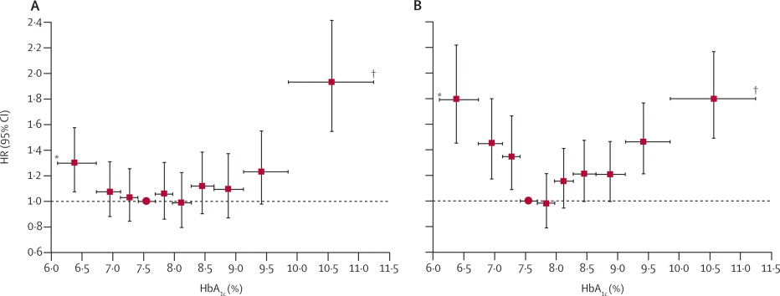
Currie et al, Lancet 2010
Oral medication
Plus insulin
Adjusted hazard ratios for all-cause mortality introducing HbA1c (%) into Cox proportional hazards model as a time-fixed or time-dependent covariate. Consists of two time-dependent covariates with data from combined cohorts. Vertical error bars show 95% CIs, horizontal bars show HbA1c range. Red circle=reference decile.

Slide 70

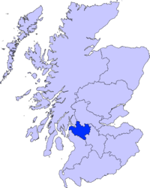
Inpatient CBG Analysis
Abbott Precision Webb
NHS Greater Glasgow and Clyde Health Board
8 acute hospitals and associated units
core population 1.2 million
specialist services 2.5 million
over 680 000 CBG per annum

Slide 71
01/01/2008 and 01/05/2013 Greater Glasgow and Clyde all adult patients with > 4 recorded capillary glucose measurements
18194 patients
Data on file 4.9.13
G Jones, C Sainsbury

Slide 72
low
CAR Sainsbury, GC Jones
DIABETIC MEDICINE 2016 32, 157-157

Slide 73
Inpatient with preadmission SU/metformin
CAR Sainsbury, SG Cunningham, GC Jones
DIABETIC MEDICINE 2016 33, 193-193

Slide 74
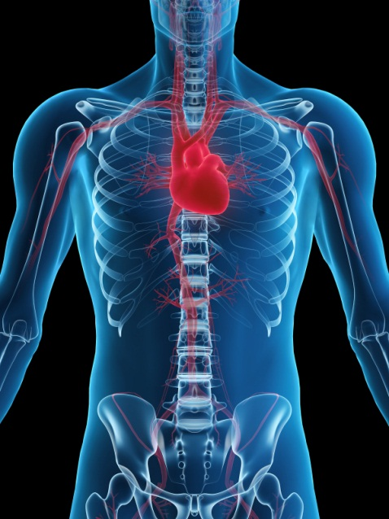
Morbidity of hypoglycaemia in the heart
Prolonged QT
Arrhythmias
Platelet Activation
Counter-regulatory response
Myocardial glucose
Notes:
74

Slide 75
Learning Point
In high risk CV disease patients hypoglycaemia should be avoided.

Slide 76
Sulphonylureas and risk of cardiovascular disease: systematic review and meta‐analysis
Diabetic Medicine Volume 30, Issue 10, pages 1160-1171, 16 SEP 2013 DOI: 10.1111/dme.12232 http://onlinelibrary.wiley.com/doi/10.1111/dme.12232/full#dme12232-fig-0002
Notes:
76
Meta‐analysis results of studies comparing sulphonylureas to non‐sulphonylurea on cardiovascular mortality. *Schramm 2011a–e were conducted in patients without prior myocardial infarction, evaluating glimepiride, gliclazide, glyburide, glipizide and tolbutamide vs. metformin,respectively. †Schramm 2011f–j were conducted in patients with prior myocardial infarction, evaluating glimepiride, gliclazide, glyburide, glipizide and tolbutamide vs. metformin,respectively. ‡Sullivan 2011a compared sulphonylurea with metformin. §Sullivan 2011b compared sulphonylurea with diet. ¶Evans 2006a compared sulphonylurea with metformin. **Evans 2006b compared combination sulphonylurea and metformin with metformin alone.
© This slide is made available for non-commercial use only. Please note that permission may be required for re-use of images in which the copyright is owned by a third party.

Slide 77
Glucose-lowering treatments and associated CV risk
Risk of cardiovascular mortality and non-fatal myocardial infarction
(6171 events)
Metformin
Sulphonylureas
Tolbutamide
Gliclazide
Glipizide
Glimepiride
Gilbenclamide
Insulin
0.8
1
1.2
1.4
1.6
1.8
Hazard Ratio (metformin reference = 1)
CV: cardiovascular
Adapted from Jørgensen CH, et al. Cardiovasc Diabetol 2010;9:54.
Notes:
77

Slide 78
Secondary prevention of macrovascular events in patients with type 2 diabetes in the PROactive Study (PROspective pioglitAzone Clinical Trial In macroVascular Events): a randomised controlled trial
Figure 3. Kaplan-Meier curve of time to main secondary endpoint**Death from any cause, non-fatal myocardial infarction (excluding silent myocardial infarction), or stroke.
John A Dormandy et al
Lancet, Volume 366, Issue 9493, 2005, 1279–1289
http://dx.doi.org/10.1016/S0140-6736(05)67528-9

Slide 79
Cardiovascular safety studies (TECOS, EXAMINE, SAVOR-TIMI)

Slide 80
Semaglutide and Cardiovascular Outcomes in Patients with Type 2 Diabetes
SUSTAIN-6 Investigators
N Engl J Med, 2016

Slide 81
Semaglutide and Cardiovascular Outcomes in Patients with Type 2 Diabetes
SUSTAIN-6 Investigators
N Engl J Med, 2016

Slide 82
LEADER trial: Primary Outcome
First occurrence of CV death, nonfatal myocardial infarction, or nonfatal stroke in the time-to-event analysis in patients with type 2 diabetes and high CV risk.
Hazard ratio, 0.87 (95% CI, 0.78–0.97)
P<0.001 for noninferiority
P=0.01 for superiority
Patients with an event (%)
Placebo
Liraglutide
Months since randomisation
Liraglutide Effect and Action in Diabetes: Evaluation of cardiovascular outcome Results (LEADER) trial
Adapted from: Marso SP et al., NEJM 2016

Slide 83
Liraglutide and Cardiovascular Outcomes in Type 2 Diabetes LEADER Trial Investigators N Engl J Med, 2016
LEADER
(N=9340)
 |  | Hazard ratio (95% CI) | P value
Primary composite endpoint* |  | 0.87 (0.78-0.97) | 0.01
Expanded composite endpoint† |  | 0.88 (0.81-0.96) | 0.005
Death from any cause |  | 0.85 (0.74-0.97) | 0.02
CV death |  | 0.78 (0.66-0.93) | 0.007
Fatal or nonfatal MI |  | 0.86 (0.73-1.00) | 0.046
Nephropathy |  | 0.78 (0.67-0.92) | 0.003
Favors liraglutide
*CV death, nonfatal MI (including silent MI), or nonfatal stroke; †CV death, nonfatal MI (including silent MI), nonfatal stroke, coronary revascularization, and hospitalization for unstable angina or HF.
CI, confidence interval; CV, cardiovascular; MI, myocardial infarction.
83

Slide 84
Empagliflozin, Cardiovascular Outcomes, and Mortality in Type 2 Diabetes Bernard Zinman et al, NEJM, 2015

Slide 85
3-point MACE
Empagliflozin 10 mg
HR 0.85
(95% CI 0.72, 1.01)
p=0.07
Empagliflozin 25 mg
HR 0.86
(95% CI 0.73, 1.02)
p=0.09
Cumulative incidence function. MACE, Major Adverse Cardiovascular Event; HR, hazard ratio
Zinman B et al. N Engl J Med 2015 DOI: 10.1056/NEJMoa1504720 Supplementary Appendix
Notes:
85

Slide 86
CV death
Empagliflozin 10 mg
HR 0.65
(95% CI 0.50, 0.85)
p=0.002
RRR: 35%
ARR: 2.1%
Empagliflozin 25 mg
HR 0.59
(95% CI 0.45, 0.77)
p=<0.001
RRR: 41%
ARR: 2.4%
Cumulative incidence function. HR, hazard ratio; RRR: Relative risk reduction; ARR; Absolute risk reduction; CER: Control Event Rate; EER: Experimental Event rate. ARR = CER – EER. Zinman B et al. N Engl J Med 2015 DOI: 10.1056/NEJMoa1504720 Supplementary Appendix
Notes:
86

Slide 87
All-cause mortality
Empagliflozin 10 mg
HR 0.70
(95% CI 0.56, 0.87)
p=0.001
RRR: 30%
ARR: 2.5%
Empagliflozin 25 mg
HR 0.67
(95% CI 0.54, 0.83)
p=<0.001
RRR: 33%
ARR: 2.7%
HR 0.68
(95% CI 0.57, 0.82)
p<0.0001
Kaplan-Meier estimate. HR, hazard ratio; RRR: Relative risk reduction; ARR; Absolute risk reduction; CER: Control Event Rate;
EER: Experimental Event rate. ARR = CER – EER.
Zinman B et al. N Engl J Med 2015 DOI: 10.1056/NEJMoa1504720 Supplementary Appendix
Notes:
87

Slide 88
Hospitalisation for heart failure
Empagliflozin 10 mg
HR 0.62
(95% CI 0.45, 0.86)
p=0.004
RRR: 38%
ARR: 1.5%
Empagliflozin 25 mg
HR 0.68
(95% CI 0.50, 0.93)
p=0.02
RRR: 32%
ARR: 1.3%
Cumulative incidence function. HR, hazard ratio; RRR: Relative risk reduction; ARR; Absolute risk reduction; CER: Control Event Rate; EER: Experimental Event rate. ARR = CER – EER
Zinman B et al. N Engl J Med 2015 DOI: 10.1056/NEJMoa1504720 Supplementary Appendix
Notes:
88

Slide 89
Adverse events
 | Placebo (n=2333) |  | Empagliflozin 10 mg (n=2345) |  | Empagliflozin 25 mg (n=2342)
 | n (%) | Rate | n (%) | Rate | n (%) | Rate
One or more AEs | 2139 (91.7%) | 178.67 | 2112 (90.1%) | 150.34 | 2118 (90.4%) | 148.36
One or more drug-related* AEs | 549 (23.5%) | 11.33 | 666 (28.4%) | 14.15 | 643 (27.5%) | 13.38
One or more AEs leading to discontinuation | 453 (19.4%) | 8.26 | 416 (17.7%) | 7.28 | 397 (17.0%) | 6.89
One or more serious AEs | 988 (42.3%) | 22.34 | 876 (37.4%) | 18.20 | 913 (39.0%) | 19.39
Rate = per100 patient-years
*As reported by the investigator Patients treated with ≥1 dose of study drug
Zinman B et al. N Engl J Med 2015 DOI: 10.1056/NEJMoa1504720
Notes:
Notes:
The proportions of patients who had adverse events, serious adverse events, and adverse events leading to the discontinuation of a study drug were similar in the empagliflozin group and the placebo group.
89

Slide 90
Adverse events consistent with genital infection
 | Placebo (n=2333) |  | Empagliflozin 10 mg (n=2345) |  | Empagliflozin 25 mg (n=2342)
 | n (%) | Rate | n (%) | Rate | n (%) | Rate
Events consistent with genital infection | 42 (1.8%) | 0.73 | 153 (6.5%) | 2.66 | 148 (6.3%) | 2.55
Serious events | 3 (0.1%) | 0.05 | 5 (0.2%) | 0.08 | 4 (0.2%) | 0.07
Events leading to discontinuation | 2 (0.1%) | 0.03 | 19 (0.8%) | 0.32 | 14 (0.6%) | 0.23
By sex
Male | 25 (1.5%) | 0.60 | 89 (5.4%) | 2.16 | 77 (4.6%) | 1.78
Female | 17 (2.6%) | 1.09 | 64 (9.2%) | 3.93 | 71 (10.8%) | 4.81
Rate = per100 patient-years
Patients treated with ≥1 dose of study drug Based on 88 MedDRA preferred terms
Zinman B et al. N Engl J Med 2015 DOI: 10.1056/NEJMoa1504720
Notes:
90

Slide 91
Numbers needed to treat comparison

Slide 92
Learning Point
Evidence for impact on CV outcomes varies between treatments.

Slide 93

Mr Purple
84 years old
CVA aphasia
Falls
Residential care
BMI 26
HbA1c 53
Metformin 1g bd /gliclazide 160 mg bd

Slide 94
Mr Purple
What are carer concerns likely to be?
Is HbA1c appropriate?
What to do next?

Slide 95
Frequency of severe hypoglycaemia increases over time
50
40
30
20
10
0
Annual prevalence of severe hypoglycaemia (%)
Severe: requiring external assistance
Type 2 DM sulphonylureas n =103
Type 2 DM <2 years insulin n = 85
Type 2 DM >5 years insulin n = 75
Type 1 DM <5 years (duration) n = 46
Type 1 DM >15 years (duration) n = 54
T2DM
SU
T2DM
< 2 yrs
T2DM
> 5 yrs
T1DM
< 5 yrs
T1DM
> 15 yrs
Error bars = 95% confidence intervals
Adapted from: UK Hypoglycaemia Study Group (2007) Diabetologia 50: 1140
12

Slide 96
Hypoglycaemia in Elderly
Over 70 s on insulin
90 % had symptomatic hypo within 2 months
Often not typical autonomic features
Neuroglycopenia common
Avoid long acting sulphonylureas
Jaap AJ, Jones GC, McCrimmon RJ, Deary IJ, Frier BM. Perceived symptoms of hypoglycaemia in elderly type 2 diabetic patients treated with insulin. Diabetic Medicine. 1998 May;15(5):398-401.

Slide 97
Learning Point
The elderly are at high risk of harm from hypoglycaemia.

Slide 98

Mrs Grey
58 yrs old
DM2 7 years
Bus driver
BMI 31
Metformin 1 gram BD
Has DNA requests to attend diabetes review
HbA1c 71
eGFR 32

Slide 99
Mrs Grey
What might the patients concerns be?
Is the HbA1c at target?
What would you do next?

Slide 100

DVLA and diabetes: Changes to standards for Group 1 vehicles (cars/motorcycles)
Changes introduced by the European Union have applied since September 2010:
Must not have had ≥1 episode of severe hypoglycaemia* within the preceding 12 months
Must not have impaired awareness of hypoglycaemia
Defined by the Diabetes Panel for Group 1 vehicles as "an inability to detect the onset of hypoglycaemia because of a total absence of warning symptoms”
*Severe hypoglycaemia: requires assistance from another person.
Department for Transport. Available at: http://www.dft.gov.uk/dvla/medical/Annex%203%20changes%20to%20diabetes.aspx?keywords=diabetes. (last accessed January 2013).
DR-3

Slide 101
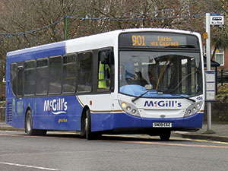
DVLA and diabetes: Changes to standards for Group 2 vehicles
Insulin-treated drivers have to meet certain requirements
Drivers treated with medication other than insulin that carries a risk of hypoglycaemia (including sulphonylureas), must meet the same criteria including but not limited to:
No severe hypoglycaemic event in the previous 12 months
Full hypoglycaemic awareness
Adequate control of diabetes by regular blood glucose monitoring, at least twice daily and at times relevant to driving**
Demonstrated understanding of the risks of hypoglycaemia
No other debarring complications of diabetes
*Severe hypoglycaemia: requires assistance from another person.
**Demonstrated using blood glucose meters with a memory function to measure and record blood glucose levels for ≥3 months.
Department for Transport. Available at: http://www.dft.gov.uk/dvla/medical/Annex%203%20changes%20to%20diabetes.aspx?keywords=diabetes. (last accessed January 2013).
DR-2

Slide 102
Cautions related to renal impairment for oral glucose-lowering therapiesª
This presentation was developed by the Boehringer Ingelheim and Lilly Diabetes Alliance UK/DIA/00288n(2) | September 2016
Mild renal impairment (CrCl 50–79 ml/min)
Moderate renal impairment (CrCl 30–49 ml/min)
Severe renal impairment (CrCl 15–29 ml/min)
End-stage renal impairment (CrCl <15 ml/min)
Metformin*
Sulphonylureas
Glibenclamide
Gliclazide
Glimepiride
Glipizide
Glibenclamide
Gliclazide
Glimepiride
Glipizide
Glibenclamide
Gliclazide
Glimepiride
Glipizide
All
Acarbose
Meglitinides
Nateglinide
Repaglinide
Nateglinide
Repaglinide
Nateglinide
Repaglinide
Nateglinide
Repaglinide
Pioglitazone
DPP-4 inhibitors
Alogliptin▼*
Linagliptin
Saxagliptin*
Sitagliptin*
Vildagliptin
Alogliptin*
Linagliptin
Saxagliptin*
Sitagliptin*
Vildagliptin
Alogliptin*
Linagliptin
Saxagliptin*
Sitagliptin*
Vildagliptin
Alogliptin*
Linagliptin
Saxagliptin*
Sitagliptin*
Vidagliptin
SGLT2 inhibitors
Canagliflozin▼*
Dapagliflozin▼*
Empagliflozin▼*
Canagliflozin*†
Empagliflozin*†
Dapagliflozin*
No dose adjustment required
Dose adjustment / caution required
Contraindicated / not recommended
ªAs described in the British National Formulary; *Assessment of renal function is recommended prior to initiation or periodically thereafter. † Should not be initiated in patients with an eGFR <60 ml/min/1.73m²; if eGFR falls below 60ml/min/1.73m² 100mg canagliflozin/10mg empagliflozin should be prescribed; empagliflozin and canagliflozin should be discontinued when eGFR is persistently below 45 ml/min/1.73m² . SmPCs for Glucophage (metformin); Glibenclamide; Diamicron (gliclazide); Amaryl (glimepiride); Minodiab (glipizide); Glucobay (acarbose); Starlix (nateglinide); Prandin (repaglinide); Actos (pioglitazone); Vipidia (alogliptin); Trajenta (linagliptin); Onglyza (saxagliptin); Januvia (sitagliptin); Galvus (vildagliptin) ; Invokana (canagliflozin); Forxiga (dapagliflozin); Jardiance (empagliflozin) all Available at: www.medicines.org.uk/emc/ (accessed September 2016).
Notes:
102

Slide 103
Learning Point
Patients need to have their driving and occupational history assessed.
Many diabetes medications are contraindicated or need changes as eGFR declines

Slide 104

Mrs Blue
63 yrs old
DM2 8 years
Retired
BMI 44
Metformin 1 gram BD
Needs knee replacement but told diabetes control and weight preventing
HbA1c 71
eGFR >60

Slide 105
Mrs Blue
What might the patients concerns be?
Is the HbA1c at target?
What would you do next?

Slide 106
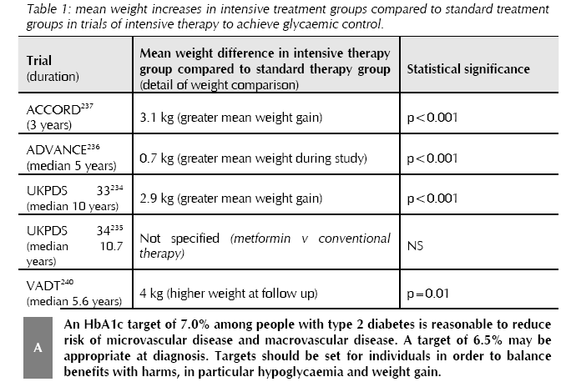

Slide 107

Glucose-lowering medications and weight profile
Range of weight change (in kg) in response to diabetes medications
10
8
6
4
2
0
-2
-4
-6
Sulphonylureas¹
Range of weight change (kg)
Meglitinides¹
Insulin¹
Thiazolidinediones¹
Metformin¹
DPP-4 inhibitor²⁻⁵
GLP-1 receptor agonist⁶
SGLT2 inhibitor⁷
Weight change (kg): -1.39 (linagliptin vs glimepiride) ², -0.6 (sitagliptin vs glipizide)³, -1.5 (sitagliptin vs glipizide)³, -0.3 (vildagliptin vs rosiglitazone)⁴, -0.2 (vildagliptin vs glimepiride), +0.1 (vildagliptin vs gliclazide)⁴, -1.1 (saxagliptin vs glipizide)⁵, -1.0 to -2.8 (liraglutide in combination with metformin, metformin + glimepiride and metformin + rosiglitazone)⁶, -1.54 to -1.89 (dapagliflozin in combination with metformin, glimepiride, and sitagliptin ± metformin)⁷, -1.68 (dapagliflozin + insulin), ⁷ -4.65 (dapagliflozin + metformin vs glipizide + metformin).⁷
Adapted from 1. Mitri J, Hamdy O. Expert Opin Drug Saf 2009; 8:573–578; 2. Boehringer Ingelheim and Eli Lilly and Company Limited. Trajenta (linagliptin) Summary of Product Characteristics. April 2013; 3. MSD Januvia (sitagliptin) Summary of Product Characteristics December 2012; 4. Novartis Galvus (vildagliptin) Summary of Product Characteristics October 2012; 5. AstraZeneca Onglyza (saxagliptin) Summary of Product Characteristics. July 2013; 6. Novo Nordisk Limited. Victoza (liraglutide) Summary of Product Characteristics. March 2013; 7. Bristol Myers Squibb Forxiga (dapagliflozin) Summary of Product Characteristics November 2012. All SPCs are available from http://www.medicines.org.uk/emc/ (accessed August 2013).
Notes:
107

Slide 108
Learning Point
Benefits of glucose lowering medications need to be balanced with potential harm of weight gain.

Slide 109
Considerations in the management HbA_{1c}
Most intensive
Less intensive
Least intensive
6.0%
7.0%
8.0%
HbA_{1c}
Age
40 years
60 years
>75 years
6.0%
7.0%
8.0%
HbA_{1c}
Hypoglycaemia
Low
Moderate
High
6.0%
7.0%
8.0%
HbA_{1c}
Established vascular complications
None
Early
microvascular
Microvascular
Adv.
microvascular
6.0%
7.0%
8.0%
HbA_{1c}
Psychosocio-economic
Highly motivated, adherent, knowledgeable, excellent self-care capacities, and comprehensive support systems
Less motivated, non-adherent, limited insight, poor self-care capacities, and weak support systems
Adapted from Ismail-Beigi et al. Ann Intern Med 2011;154:554–559.
Notes:
Questions to consider when monitoring and managing HbA1c:
Is the agreed target appropriate for this person’s age, comorbidities, cardiovascular risk, living situation and other issues?
In other words, do the risks of achieving the targets outweigh the benefits?
What are this person’s aspirations in relation to his or her glycaemic control?
Should we really be trying to achieve the lowest QOF indicator for HbA1c in this person?
Age:
ACCORD
Trend toward lower all-cause mortality among participants aged <65 years at baseline who were assigned to standard treatment (P=NS)
ADVANCE
Lower rates of combined major- and macrovascular events in younger patients in the intensive therapy group (P=NS)
VADT
Patients with lower coronary calcium scores had fewer CVD events with intensive control
Risk of hypoglycaemia:
2.7% of intensely managed patients with T2D experience an annual severe hypoglycaemic event vs 1.5% of conventionally managed patients
The cost of single episode of severe hypoglycaemia is approximately $600
Recurrent hypoglycaemic events may result in hypoglycaemia-associated autonomic failure (HAAF)
A single non-severe hypoglycaemic episode occurring at work typically results in lost productivity of up to 10 hours
A non-severe hypoglycaemic episode outside of work results in people arriving late for work up to 24% of the time
Macrovascular disease:
Patients with more advanced CVD show no reduction in CVD events with intensive glycaemic control
Microvascular disease:
More aggressive glycaemic control may be considered in patients with microalbuminuria without elevated serum creatinine levels or in patients with early retinopathy
Strict glucose control does not alter progression of renal disease once serum creatinine level is elevated

Slide 110
Any Questions?

